Slide 1
Ledification of railway assets
Energy Network, Paris – 02/07/2018
Wim Bontinck
Chairman EES Platform
Environmental and energy manager NMBS/SNCB

Slide 2
Drivers for relighting or relamping
Need for renewal of electricity installations – technical and legal conformity
More efficient maintenance – rotatable lighting poles, longer life span of lamps
Renewal platform to standard height of 930 mm
Lower prices for LED -technology
More energy efficient light
More intelligent lighting

Slide 3
Energy efficiency of lamps (lumen/Watt)

Slide 4
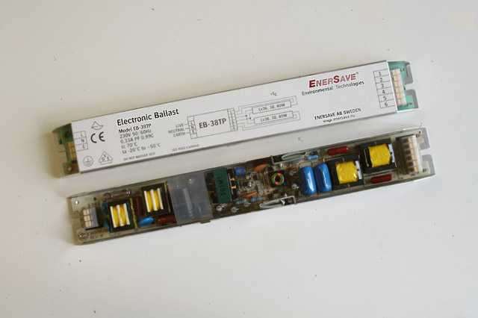
Energy efficiency of lighting (lumen/Watt)
light source
auxiliary
luminaires
classical magnetic ballast: consumption +20%
Electronic ballast

Slide 5
Relighting of NMBS station platforms
136 stations with station building
420 stations without station building
50 relighted in 2016-2017
85 planned in 2018
So 25% in 2018
Goal:
50% in 2022
100% in 2030

Slide 6
Standard small railway station
Electricity need
LED-Lighting of 2 platforms of 150 – 400m long, 4m wide [7h/24h, 7d/7d]
LED-Lighting of bicycle parking [11h/24h, 7d/7d]
1 TVM (ticket vending machine)
Other small electronic equipment such as audio speakers
Eventually LED-lighting of a passenger tunnel under the tracks [24h/24h, 7d/7d]
About 10 MWh/year of which 6 for lighting
Marginal electricity cost of about 150 EUR/MWh
Simple regulation (day light sensor and clock)
With more complex lighting regulation a maximum of about 2 MWh good be avoid but no business-case

Slide 7
Relighting of car parking buidings
 | # places 2017 | # places 2020 | % places with LED lighting in 2017 | ambition % places with LED lighting in 2022
Parking building | 6.800 | 10.750 | 24% | 50%
Underground parking | 7.100 | 9.850 | 9% | 70%
100% in 2030

Slide 8
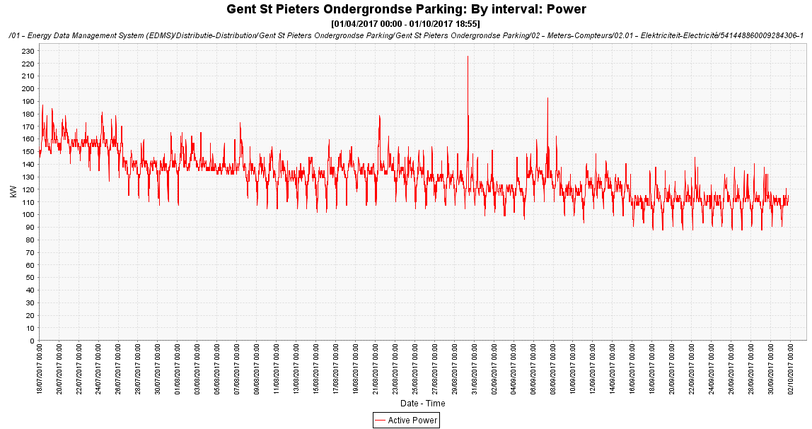
e.g. underground parking of Gent-Sint-Pieters
Before 2000 T5 49 Watt; Now 2000 Led-tubes 23 Watt
-50 kW
Pay-back time= 1,5 year
160 kW
110 kW
Juin 2017
September 2017

Slide 9
Relighting of rolling stock maintenance workshop
M² workshop in 2017 | M² workshop in 2022 | % with LED lighting in 2017 | ambition % with LED lighting in 2022
425.000 | 390.000 | 16% | 50%
100% in 2030

Slide 10
“Ledification” facts
LED = state of the art in new buildings (and trains)
Big diversity in quality of LED
Technological evolution still progressing
Lower prices, less energy consumption and longer life span of LED generates business opportunities

