Slide 1
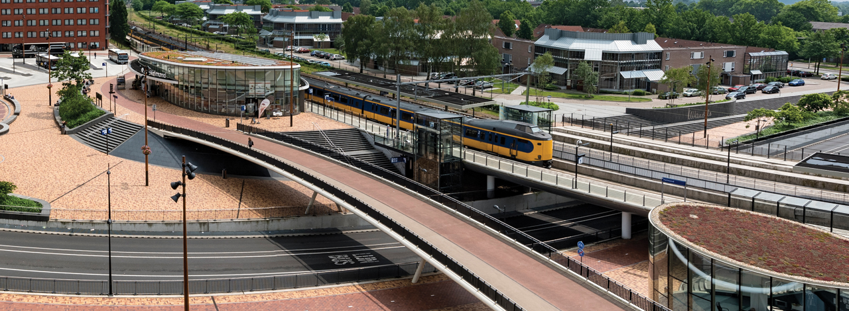
From light to sight.
Ted Luiten, energymanager
ProRail document T20150102-1658833467-2907

Slide 2
Origin and development
Originally:
initiated as a program to meet EU-regulations concerning accessibility.
Later included:
Improvement of other aspects such as environment, energyconsumption, dazing of traindrivers.
Long term maintenance and overhaul of lighting systems.

Slide 3
Outline of the program
400 stations, 4 years, appr. 65 mio€.
Technical improvements:
LED equipment
Smart switching
Smart dimming
Integration of detection, speakers, light, clock etc.

Slide 4
Objectives
Optimal accessibility of stations for (visually) disabled passengers. Meeting TSI-PRM.
Reduction of energy consumption:
50% less for lighting of stations (actual 20.288 MWh/ann),
-6 kton CO₂/annum
Equal levels of brightness all over the platform
Reduction of life cycle costs.
Reduction of light pollution

Slide 5
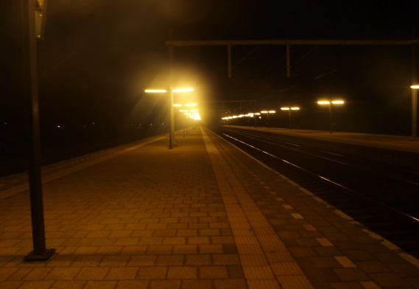
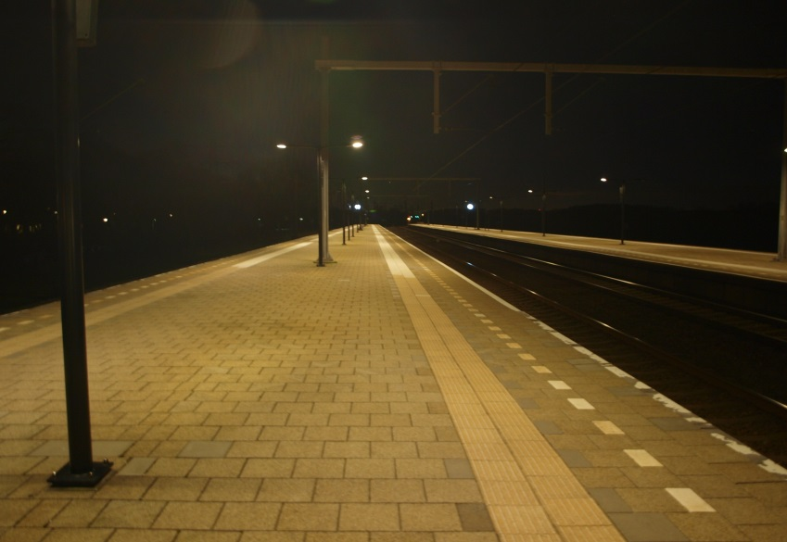
Even levels of brightness, reduction of dazing
Before
After

Slide 6
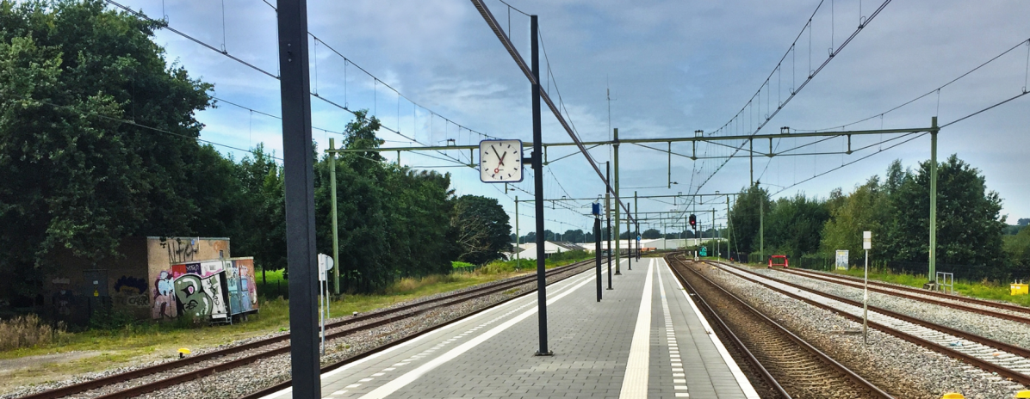
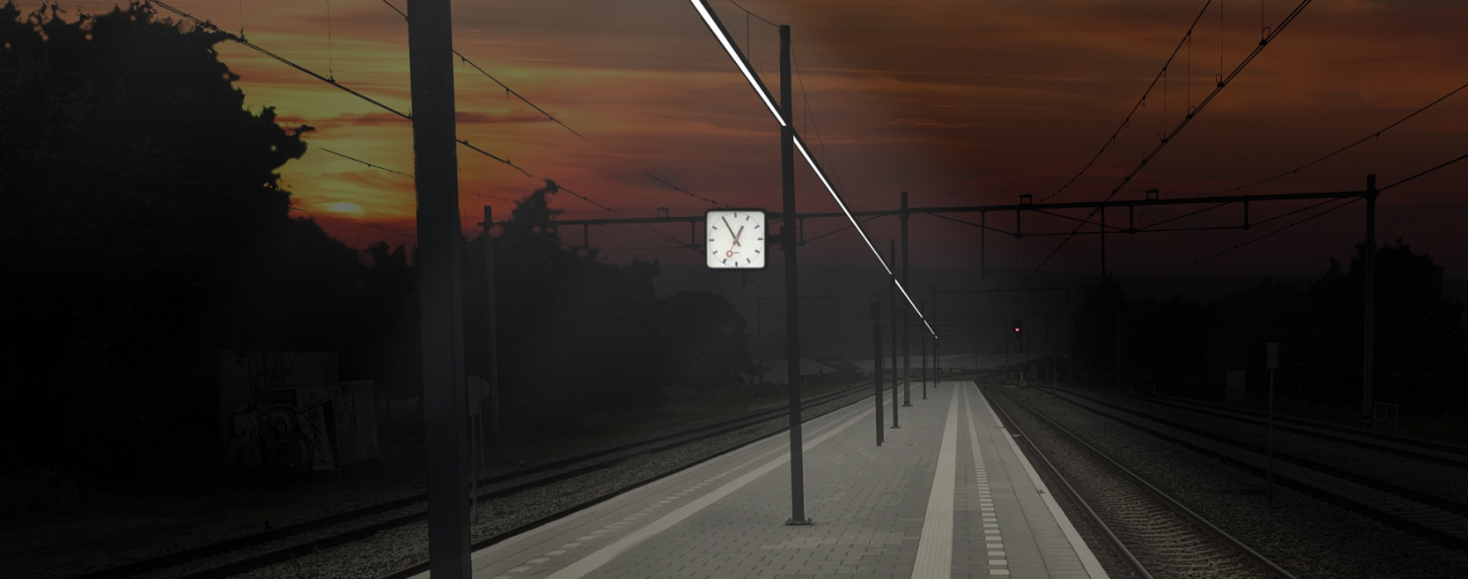
Reduction of obstacles on the platform

Slide 7
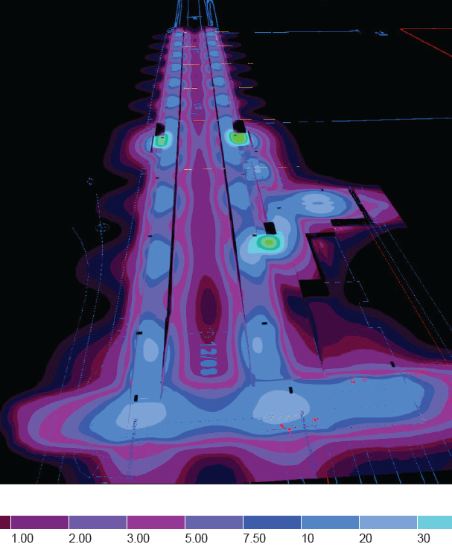
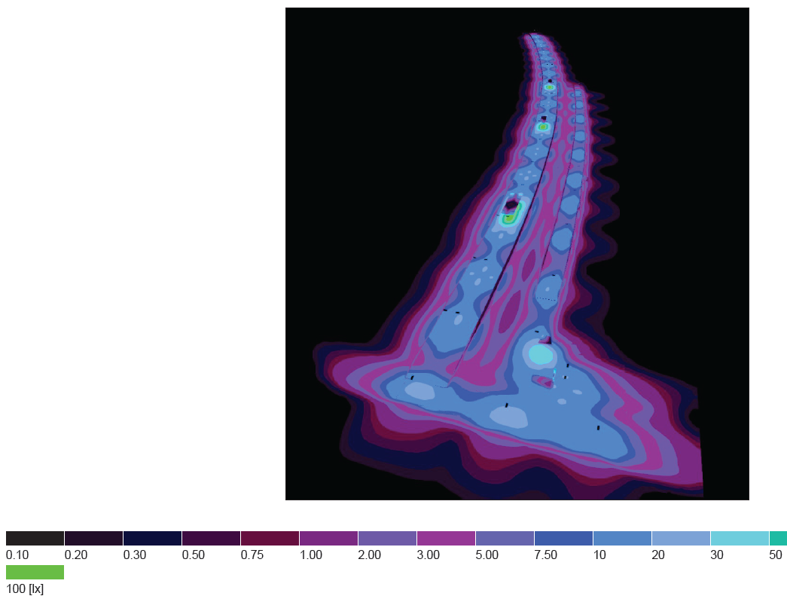
Controlled design of light and brightness

Slide 8
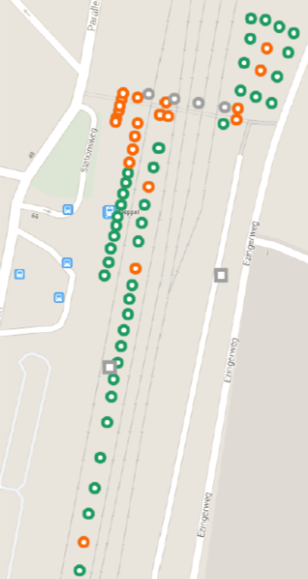
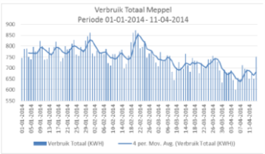
Effects of dimming and detection.

Slide 9
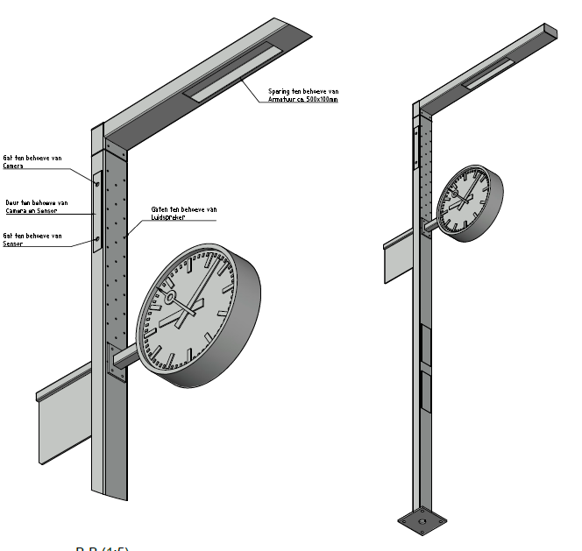
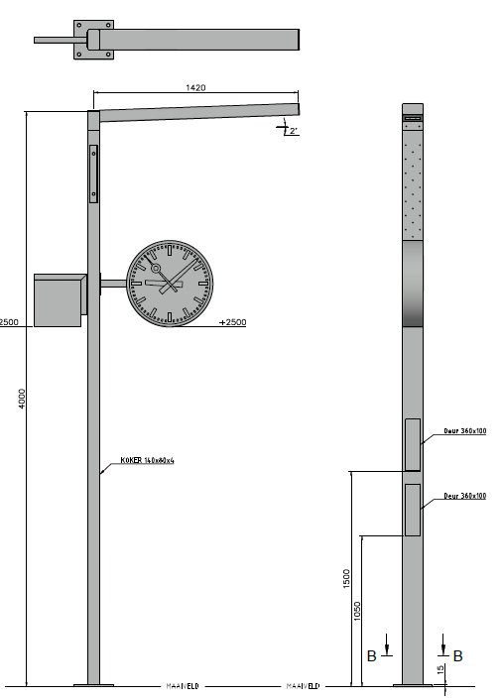
Multi-purpose lampposts

Slide 10
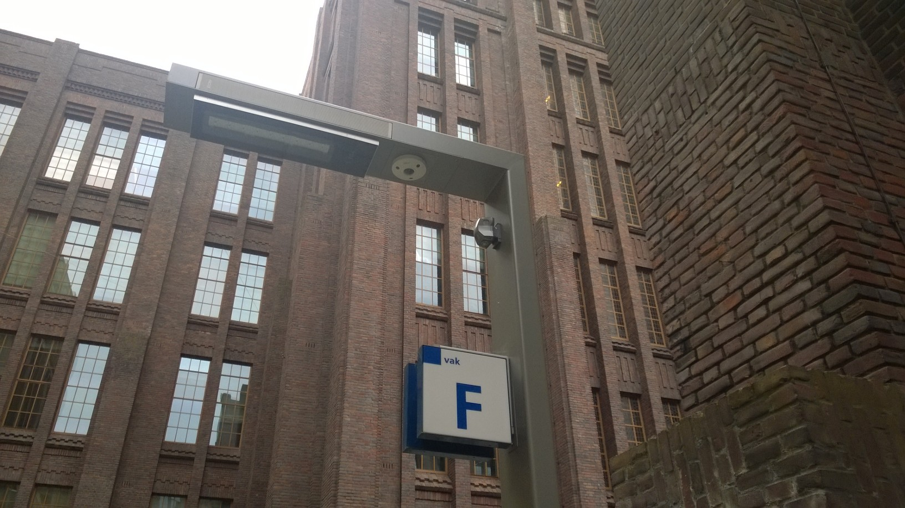
Actual conceptual design

Slide 11
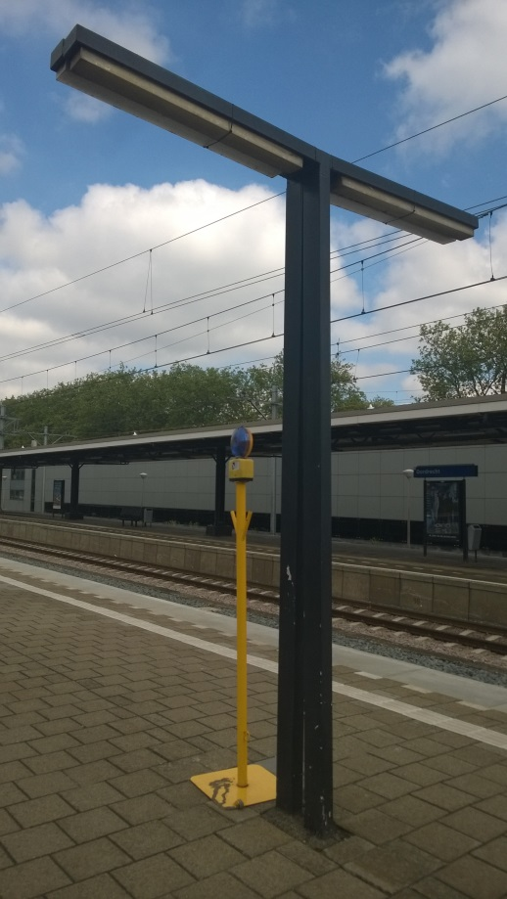
Any questions?

