Slide 1
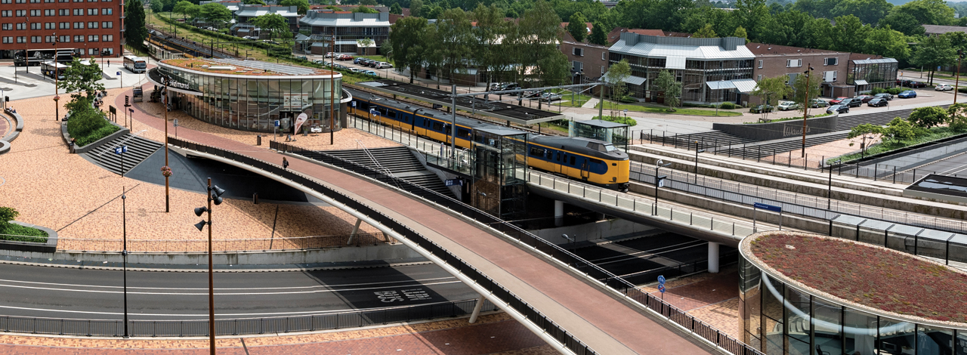
Smart monitoring of points and switches.
Ted Luiten, energymanager
ProRail document T20150102-1658833467-2908

Slide 2

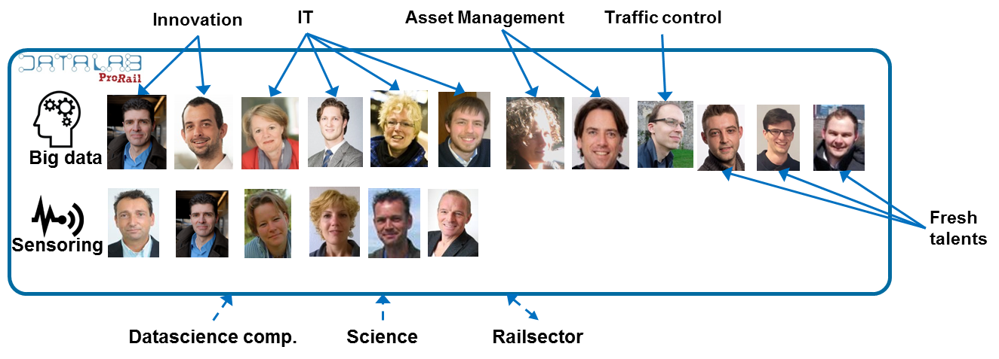


DataLab – foundation
People
coalition of
departments
datacientists
Platform
Hadoop cloud
Open source
Process
Scrum
Datascience cycle
System
understanding
Modelling
Data search
Analyzing
Data improvement

Slide 3
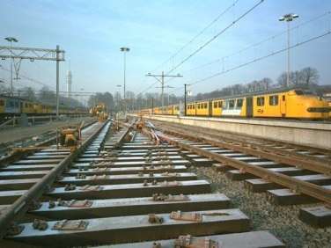





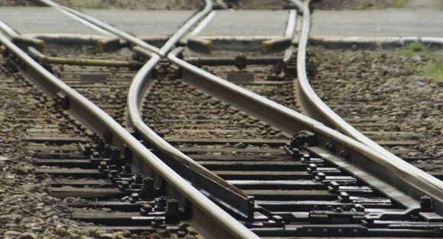
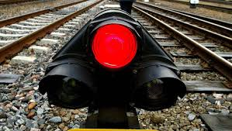
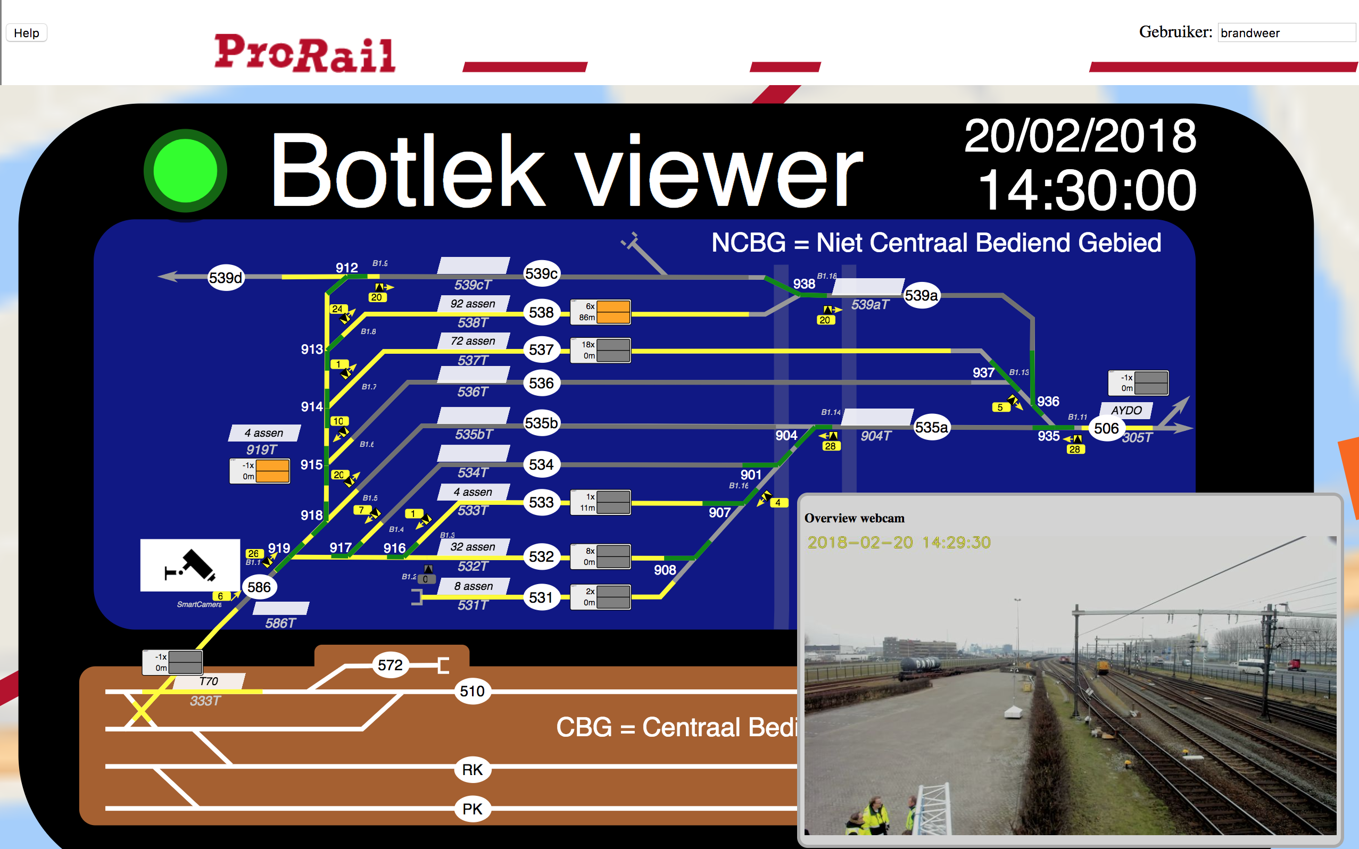
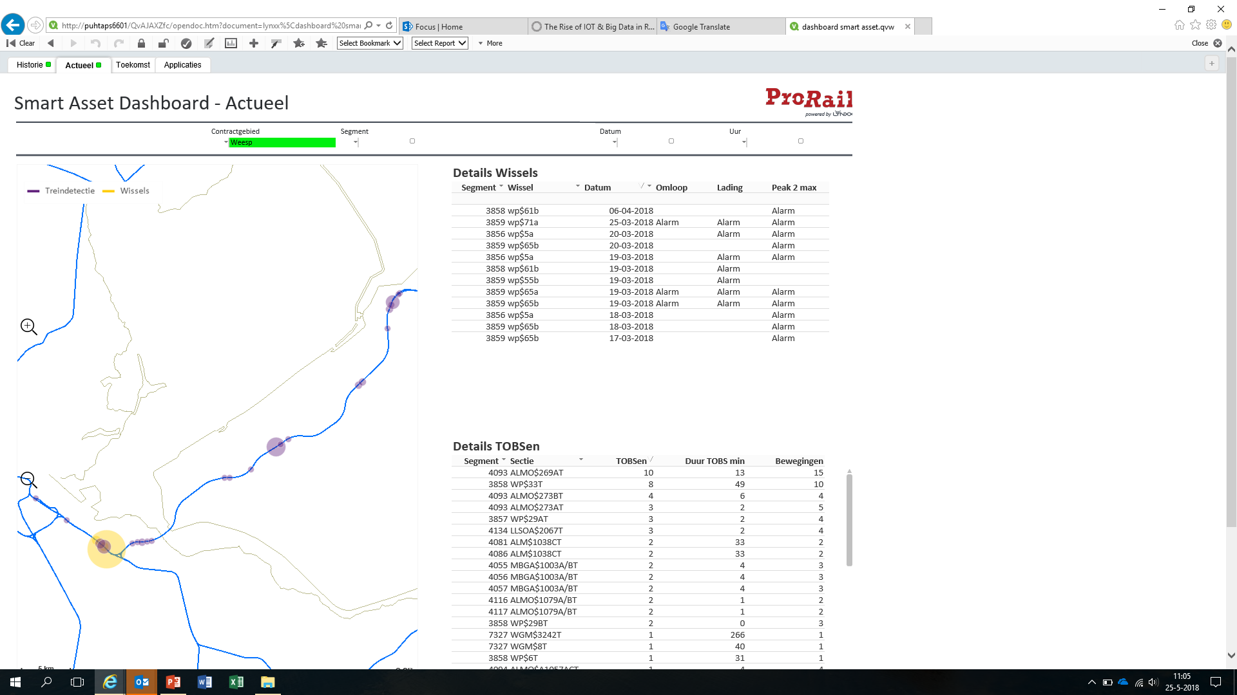
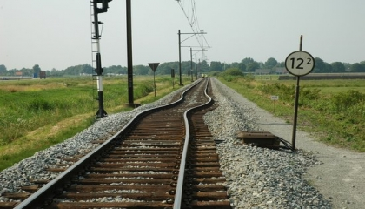
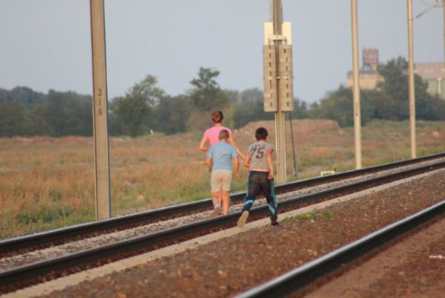
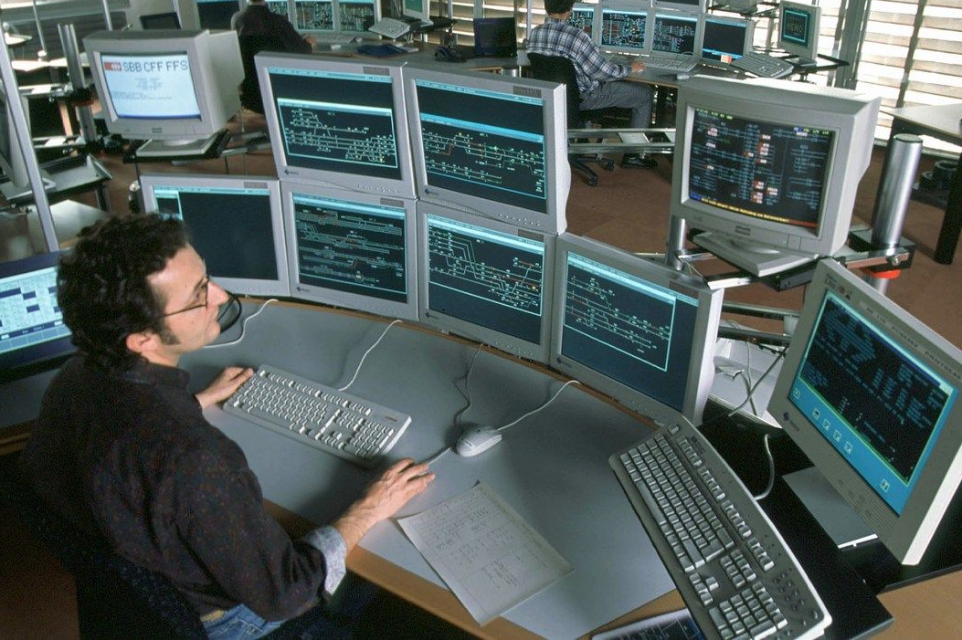
Data intelligence
Sensoring
& tracking
Data
engineering
Data
intelligence
Dashboards
& insights
Action in
operation
Infra disturbance – top 4
Tresspassers, animals
Switches
Traindetection
Track
Assets
Logistics
Switches
Treindetection
Smart asset dashboard
Track
Tresspassers, animals
Traffic control

Slide 4
Data intelligence - assets
Tresspassers & animals
Traindetection
Point switches
Track
Data
Reported trespassers
Inhabitants & char.
Schools, camping, p.o.i.
Events, weather, holidays
Railway
Surrouding area
Section occupations
Train positions
Reported defects
Maintenance
Weather
Switch movements
Motor current
Maintenance
Weather
Switch characteristics
Train movements
Measurement trains
Reported geometry & defects
Track configuration
Maintenance
Train movements
Techn.
Support vector machines
Regression
Combi of Classification,
Anomaly det., Neural nets
(log) Regression
Output
Predictive dashboard
Condition dashboard
Predictive dashboard
Condition dashboard
Predictive dashboard
(Condition dashboard)
Predictive dashboard
Status
Doubled chance of arrest
Nationwide in use
railway police
Nominated for innovation price
Pilot condition monitoring
successful (100% rate)
Nationwide
implementation started
Develop predictive
Pilot running
Discussion with contractors
on relation performance contracts vs. predictions by ProRail
In development, first tests
Next: combination with
monitoring from passenger
trains

Slide 5
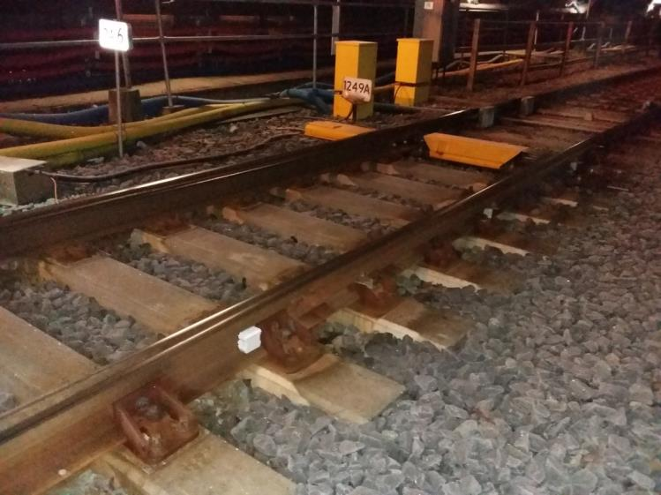
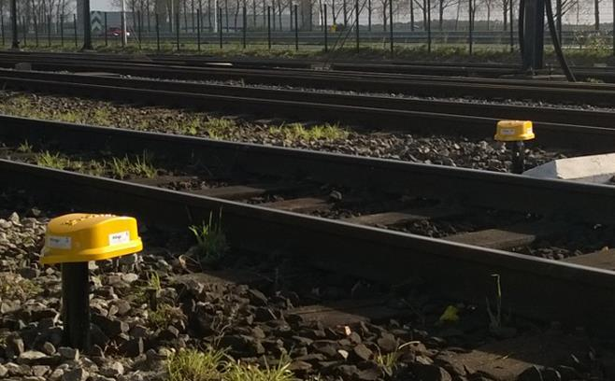
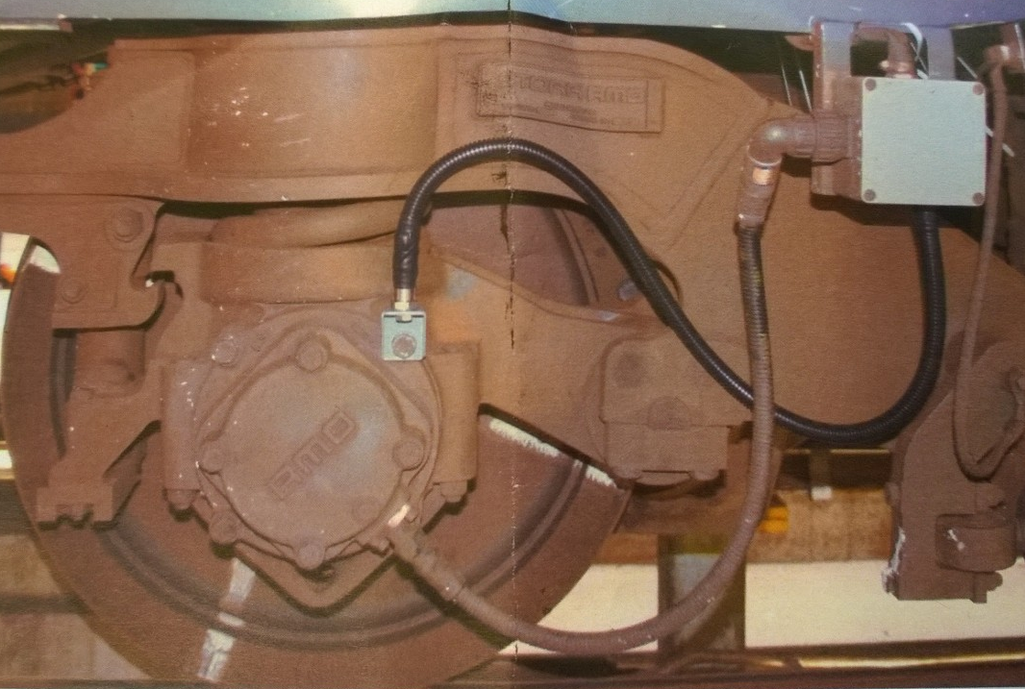
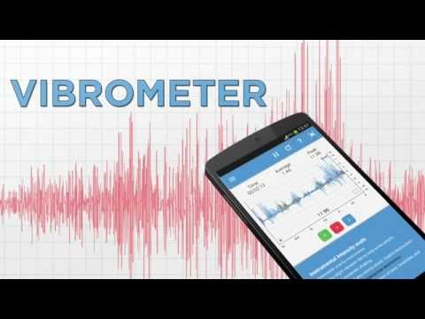
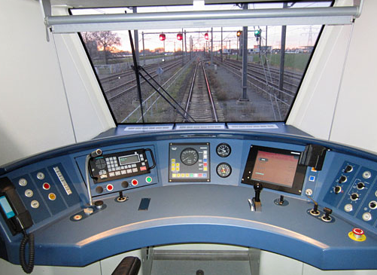
Sensoring
Sensoring
& tracking
Data
engineering
Data
intelligence
Dashboards
& insights
Action in
operation
Monitor infrastructure
Monitor trains
From
infra
Infra -> Infra
Infra -> Train
From
train
Train -> Infra
Train -> Train
Passengers -> Infra

Slide 6
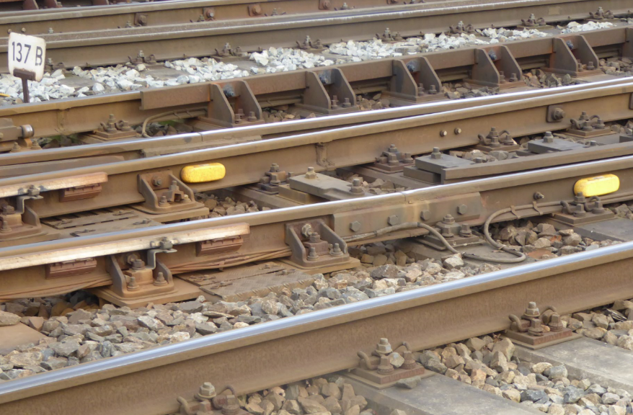
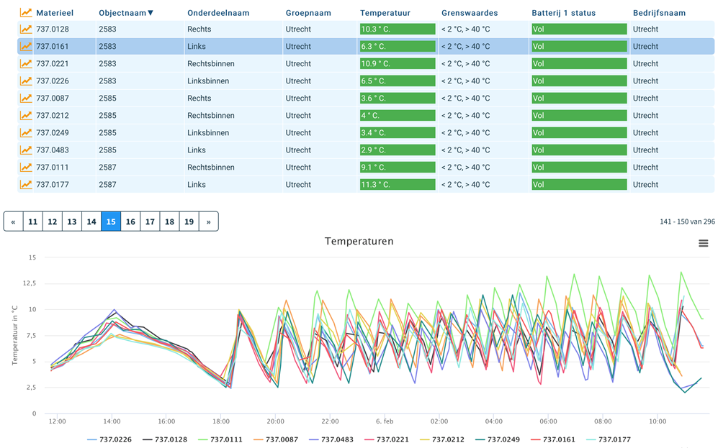
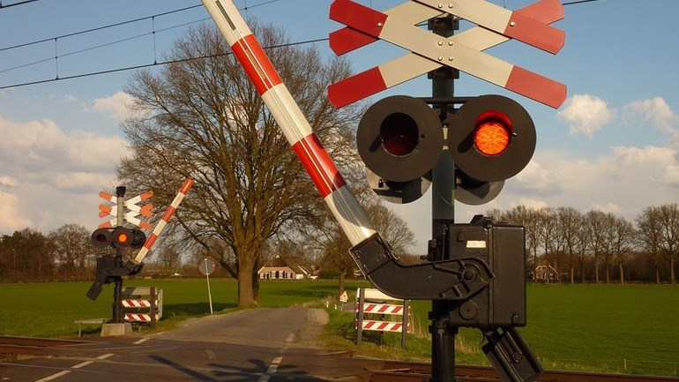
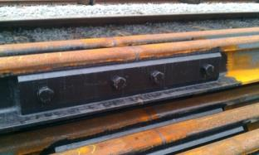
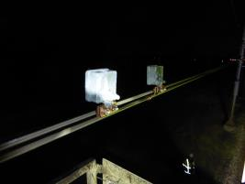
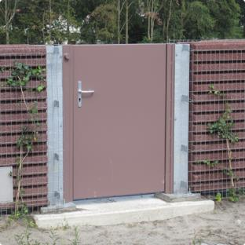
Infra – infra sensoring
Switch sensors (2.000 placed)
Crossings
Wire
Doors
Joints

Slide 7
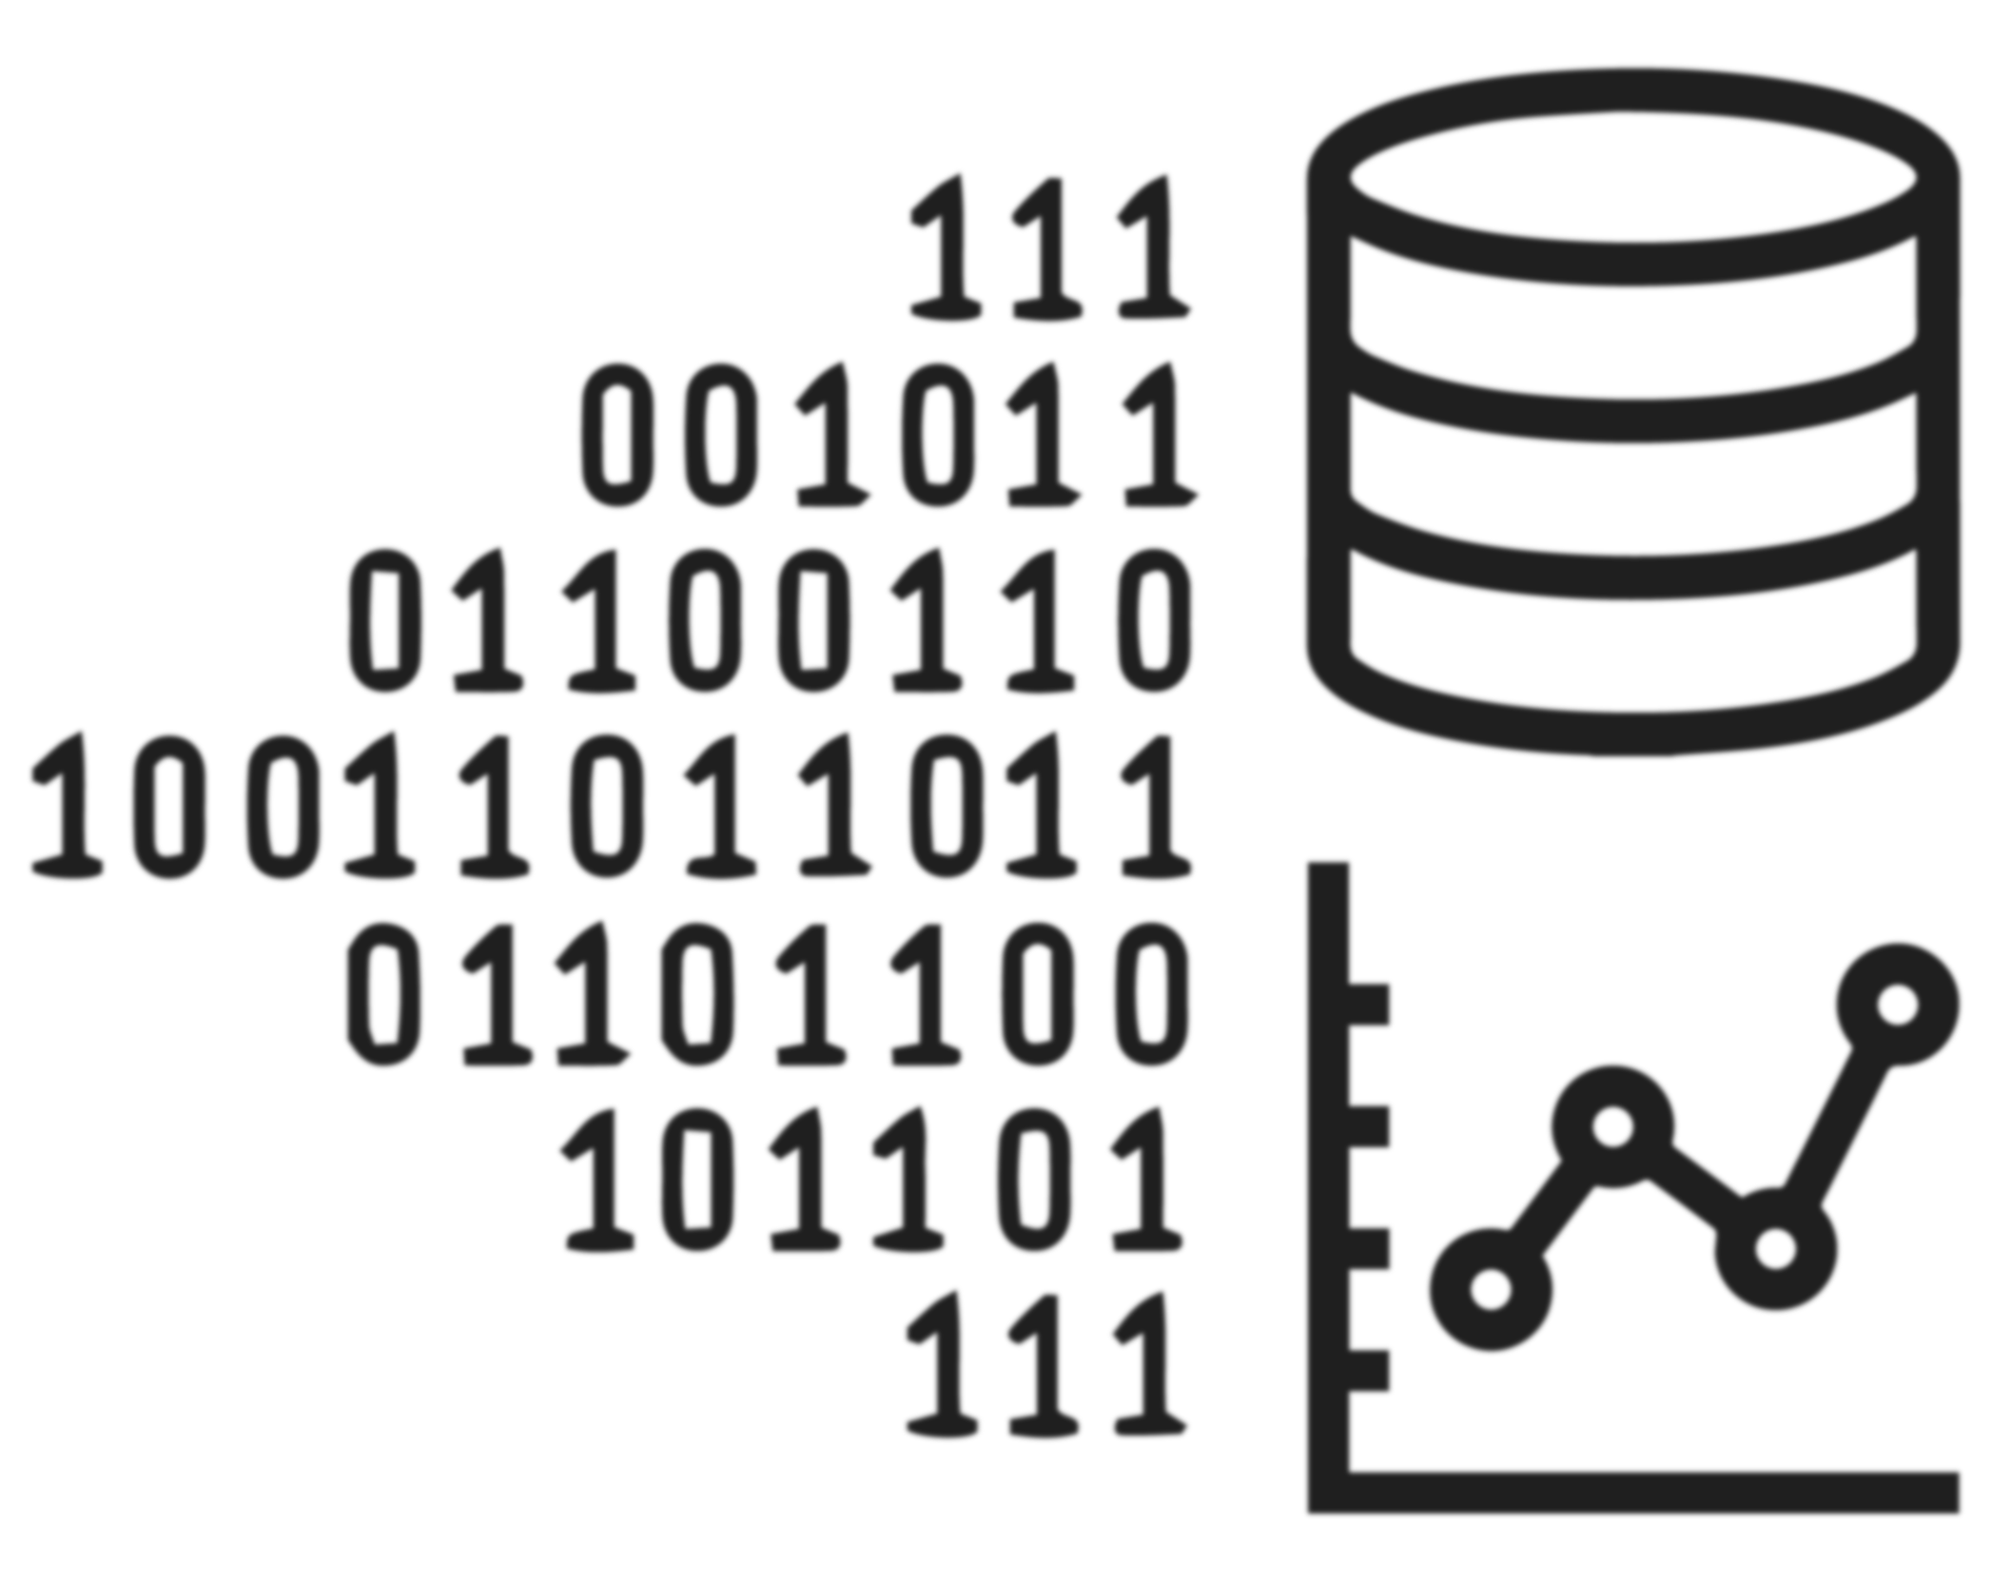

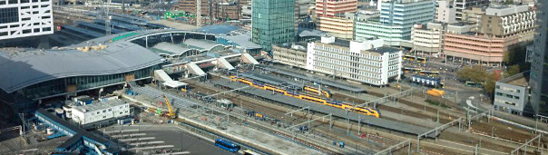
              | DataLab
Datadriven innovation in Dutch railway infrastructure
More info? Contact:
paul.vandervoort@prorail.nl

