Slide 1
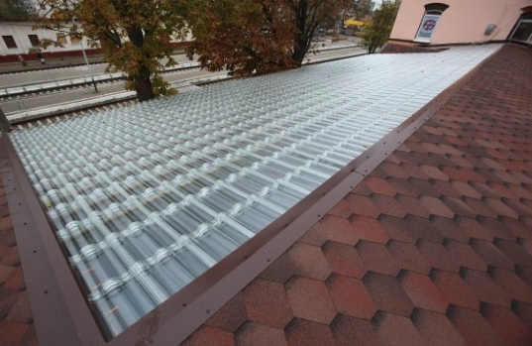
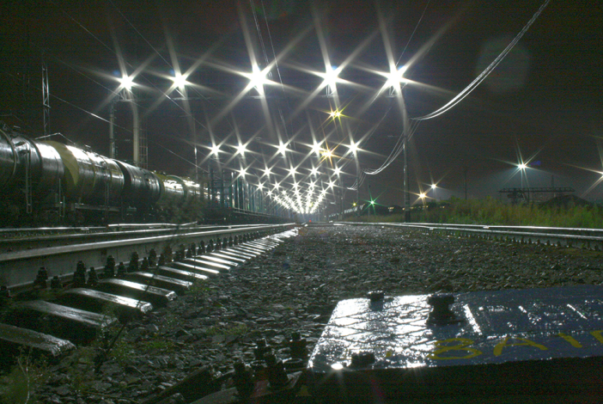
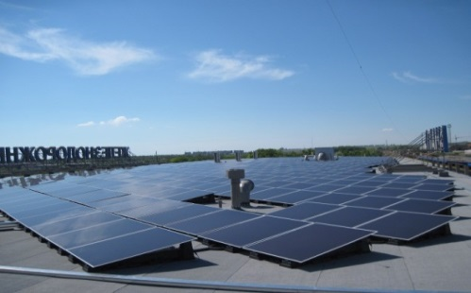
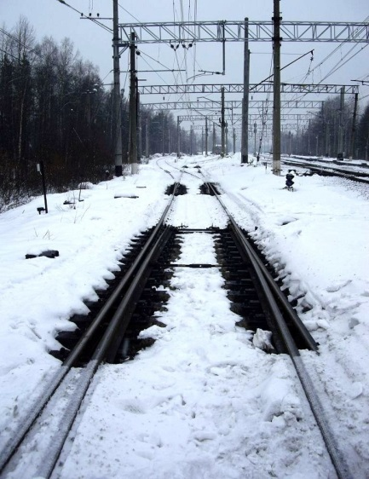
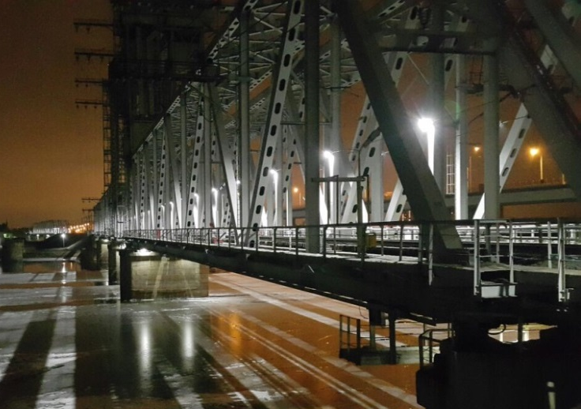
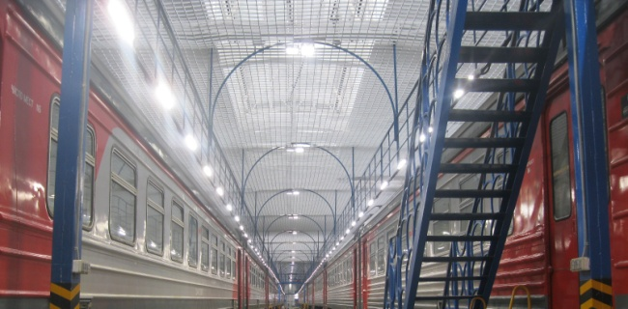
Use of energy efficient technologies and renewable
energy sources on infrastructure of Russian Railways
Department of Technical Policy JSCo «RZD»
BORIS IVANOV

Slide 2
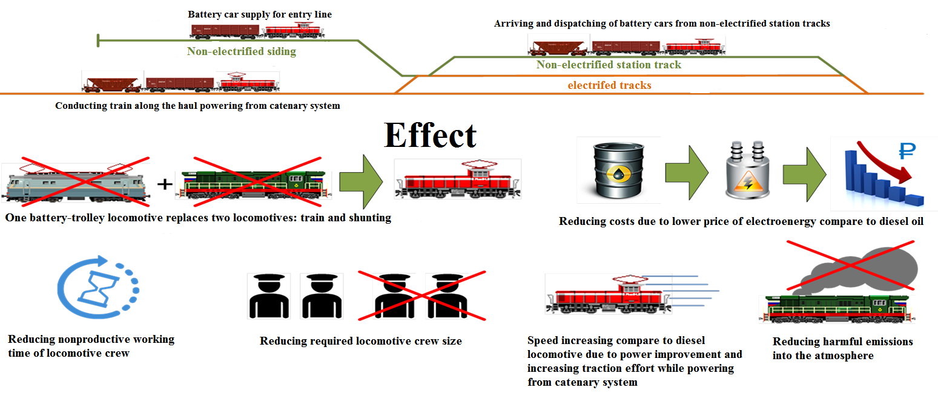
Perspectives of using locomotives with energy storage units
Implementation of battery-trolley locomotives to work with cluster freight wagons
Notes:
Co-project of RZD and RUSNANO:
Creating shunters with Li-Ion batteries
Diesel oil economy is up to 30…50% by using diesels of lower power, having antifreeze cooling system, which helps to shut down the engine while dwelling even in cold periods;
Increasing maintenance intervals, reducing labour costs for lower power diesels that causes reducing maintenance costs for hybrid locomotives up to 40%;
accomplishment of social tasks in quality improvement during passenger loading and unloading (reducing gas emissions, smokiness, and noise at stations within cities and towns)

Slide 3
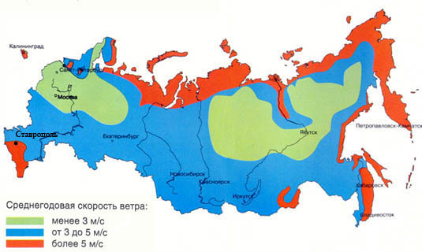
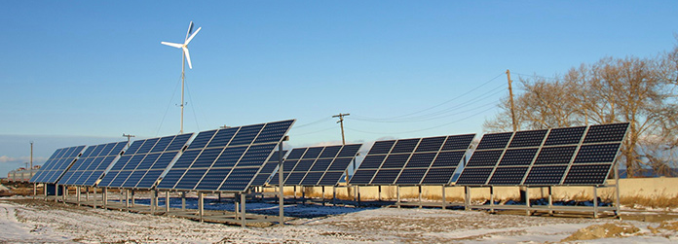
APPLICATION OF WIND-GENERATORS
Energy wind zones in Russia are located, mainly, on the coast of the seas and oceans and make up almost 5 million square meters.
In the RZD there are several wind power stations, used mainly to gain practical experience in their application.
RZD may not receive government subsidies for the sale of excess electricity, because it is a large electric grid company that is prohibited from selling produced electricity.
And the cost of electricity in the capacity market does not allow to recoup the costs of building power plants on renewable energy sources.
Average annual wind speed:
less then 3 m/s
from 3 to 5 m/s
more then 5 m/s
Hybrid (sun/wind) power station on the shore of Lake Baikal, station Misovaya

Slide 4
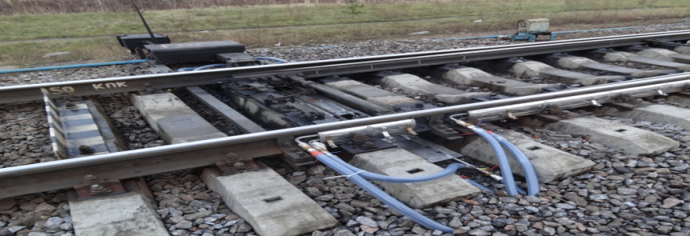
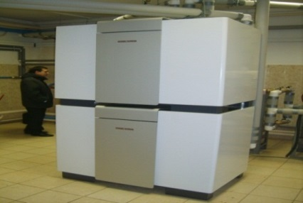
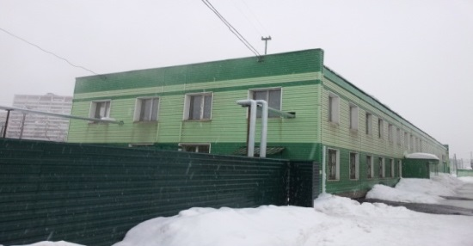
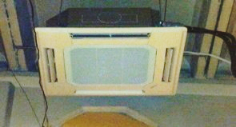
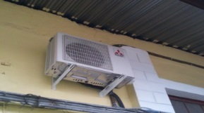
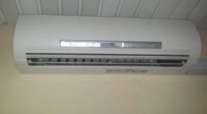
HEAT PUMPING APPLICATION
Low-grade heat sources:
Heating of switches
1 Soil heat : (Climatic zones: I, II, III)
In JSCo «Russian Railways» there are more than 165 thousand turnouts. As many are located on the paths of different enterprises and departments.
Effect: reduction of electric power consumption in comparison with traditional electric heating systems
Heating of the objects of marshalling complexes of classification yards (the heat of the circulating water of the compressor cooling system is used)
2. Heat of technological processes(I – IV)
In JSCo «Russian Railways» there are about 150 marshalling complexes.
Effect: reduction of operating costs, autonomous heating of buildings, environmentally friendly technology
3. Heat of air : (Climatic zones: I, II, III)
Heating of warehouse complexes, production
buildings and structures
There are about 150 material warehouses in JSC «Russian Railways».
Effect: lower operating costs, combined protection of buildings.

Slide 5
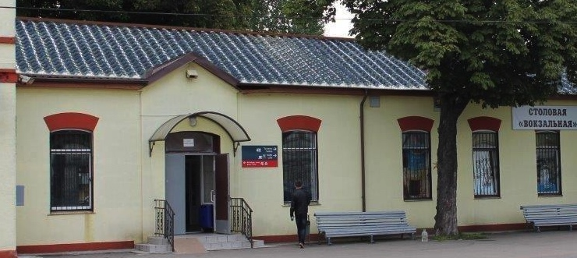
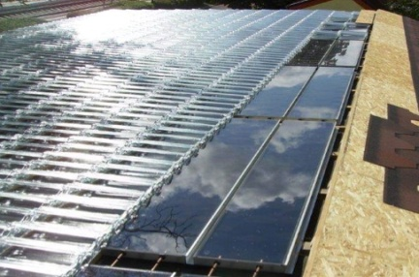
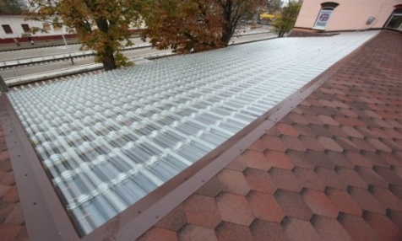
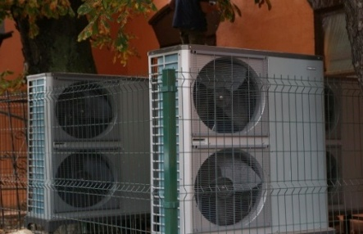
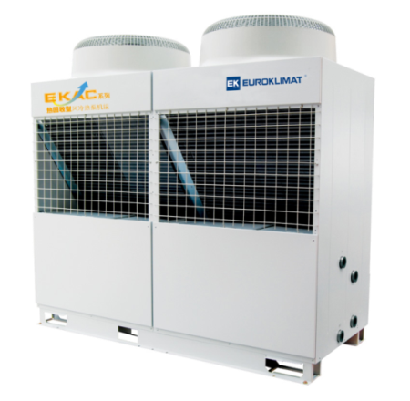
USE OF RENEWABLE ENERGY RESOURCES BY KALININGRAD REGION STATIONS
outdated boilers of Russian Railways (coal and fuel oil) closed in Russian cities over the last seven years during the implementation of the Programme to expand the use of renewable energy resources at railway facilities
44
Combined energy supply system of the Zelenogradsk station of Kaliningrad Railways
Фотоэлектрические модули
Тепловые насосы воздух/вода
As part of the programme to modernise Russian Railways heat supply facilities in the Kaliningrad Region, 16 facilities switched to renewable heat energy resources with the closure of outdated coal boilers

Slide 6
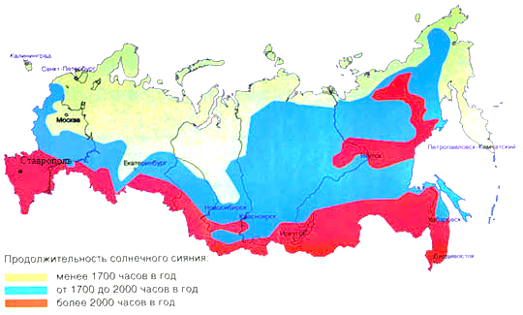
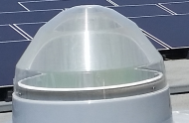
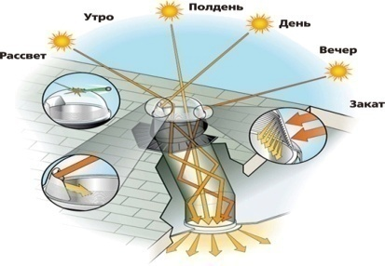
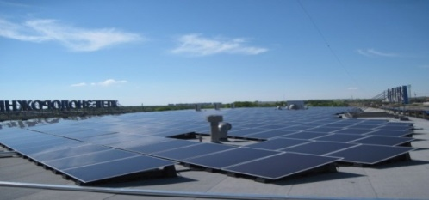
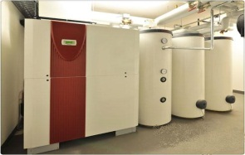
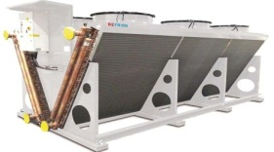
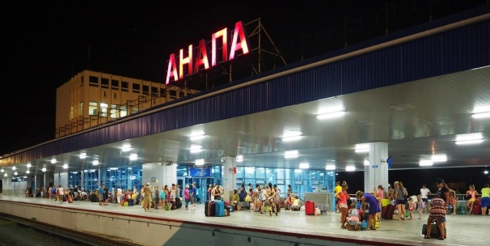
‘SMART STATION’ PROJECT STATION MODERNISATION IN ANAPA
The concept of a “Smart Railway Station” is designed for mandatory use when developing projects for the new construction and reconstruction of railway stations and transport interchange hubs at Russian Railways
The updated Concept contains more than 80 regulatory and technical documents in safety, energy efficiency, ecology, informatisation and the unified control of station engineering support systems
The implementation of the Concept at the Anapa station made it possible to provide autonomous electric and heat supply to the station solely through the use of renewable energy sources.
Solar light pipe
Hybrid LED lighting system
Solar module system
Hot air pump units
Dry cooler

Slide 7
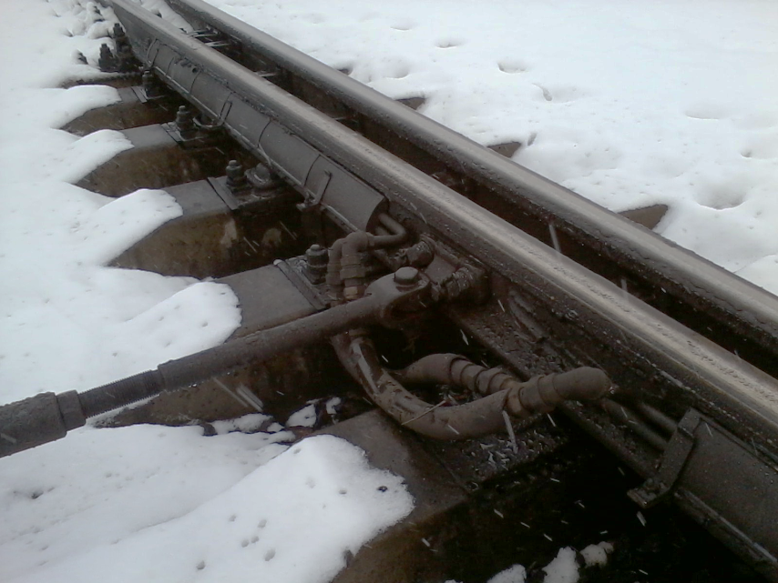
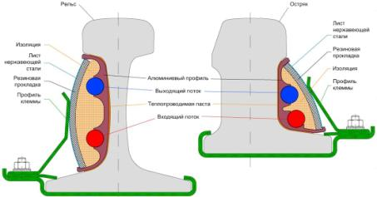
TURNOUT GEOTHERMAL HEATING SYSTEM
The innovative turnout heating system utilises a virtually inexhaustible source of energy – underground heat. The heat pump with its modern regulation system and improved rail heat exchangers make it possible to heat turnouts in a reliable, regulated and eco-friendly manner. A modern smart control and regulation system ensures the supply of heat to turnouts as needed as a result of which the unit is not constantly in the on mode.
The weather station monitors precipitation, humidity and temperature and based on their mixture the control system selects the operating mode. This station consists of a closed vandal-proof detection head installed in the track zone.

Slide 8
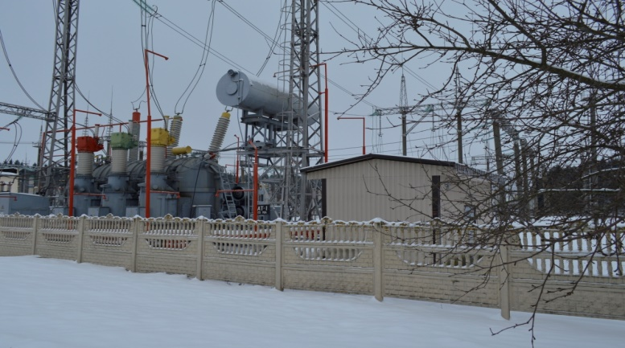
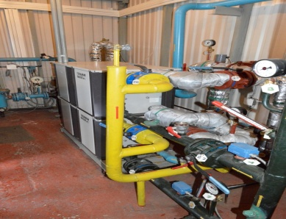
HEAT MODE CONTROL SYSTEM OF TRACTION SUBSTATION TRANSFORMERS
The traction transformer temperature control system is designed to stabilise the temperature of transformer lubricants at a consistent level that does not depend on seasonal changes to the surrounding temperature or the conditions of a transformer’s current load.
Heat is actively removed using modern heat pumps that make it possible to reuse the heat that is emitted for heat coolant in the central heating and hot water supply system of traction substation buildings and structures.

Slide 9
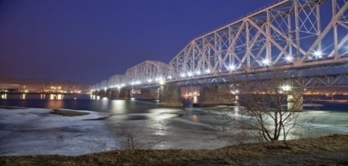
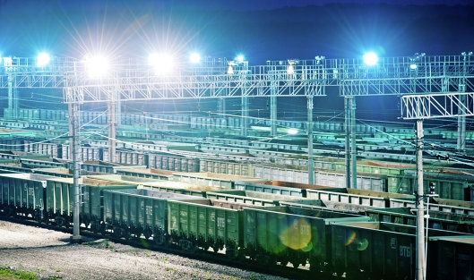
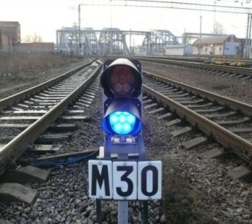
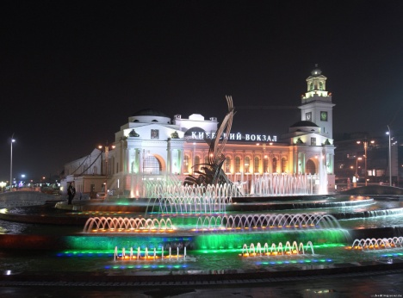
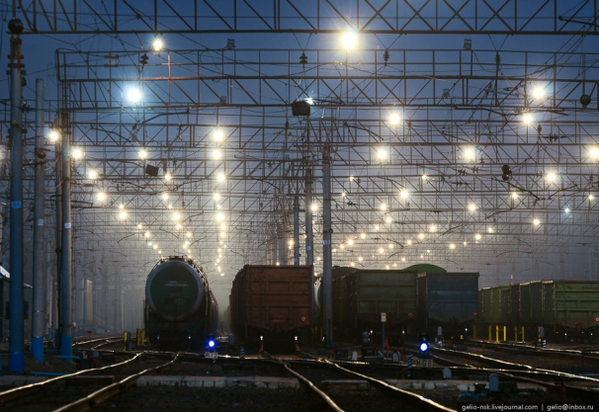
ENERGY EFFICIENT LIGHTING SYSTEM FOR STATION DEPOTS WITH AUTOMATED CONTROL
Investment over 2007-2015 totalled 4.1 bln roubles
35,970 crossing light signals
9,247 three-digit mounted light signal heads with LED modules
5,060 route and position indicators
113 railway stations (railway lighting)
43 locomotive, multiple unit and railcar repair depots
47 passenger platforms
12 railway bridges
22 railway stations
Severomuysky Tunnel

Slide 10
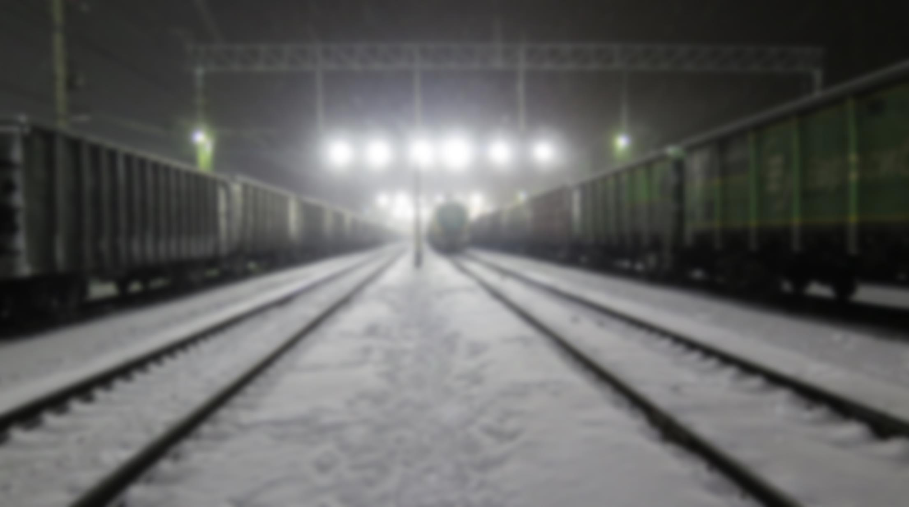
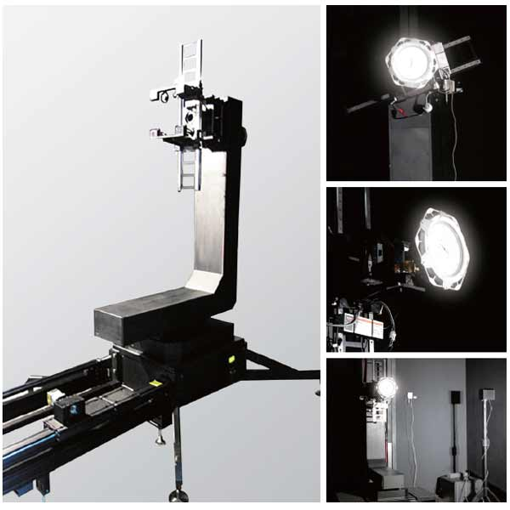
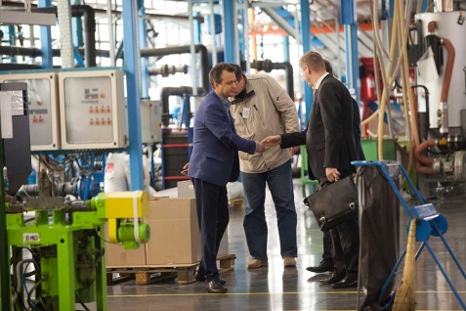
10
COMPOSITION OF INTEGRATED TECHNICAL EXPERTISE OF LED ELECTRONICS
1. Analysis of design documentation
2. Light engineering tests
3. Tests for resistance to mechanical influences
4. Tests for resistance to climatic influences
5. Tests for compliance with the degree of protection of the shell and electrical safety
6. Tests for electromagnetic compatibility
7. Visual inspection of structural features of the device and its components
8. Technological audit of production and quality control

Slide 11
THANK YOU FOR ATTENTION

