Slide 1
Energy measurement
Energy efficient infrastructure
Bart Van der Spiegel
Energy Management bart.vanderspiegel@infrabel.be
2 July 2018

Slide 2
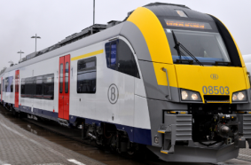
Production
Purchasing by Infrabel
Consumptions
Transmission
‘Traction’-contract:
65 connections on transmission network of Elia (88 %)
20 connections to distribution networks (12 %)
1350 GWh
Traction-energy:
Energy consumption of trains
(Railway Undertakings)
130 GWh
Distribution-energy:
Energy for electrical installations of Infrabel, SNCB and third parties (signalling, switch heating, platform lighting, stations, maintenance shops, etcetera).
Distribution
‘Distribution’-contract: 1400 connections to distribution networks
140 GWh
2

Slide 3
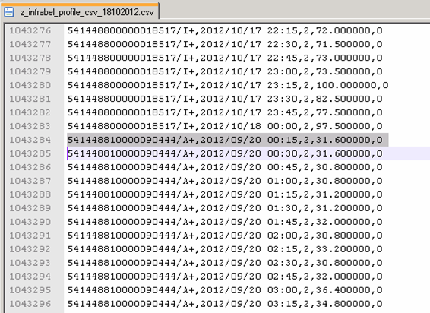
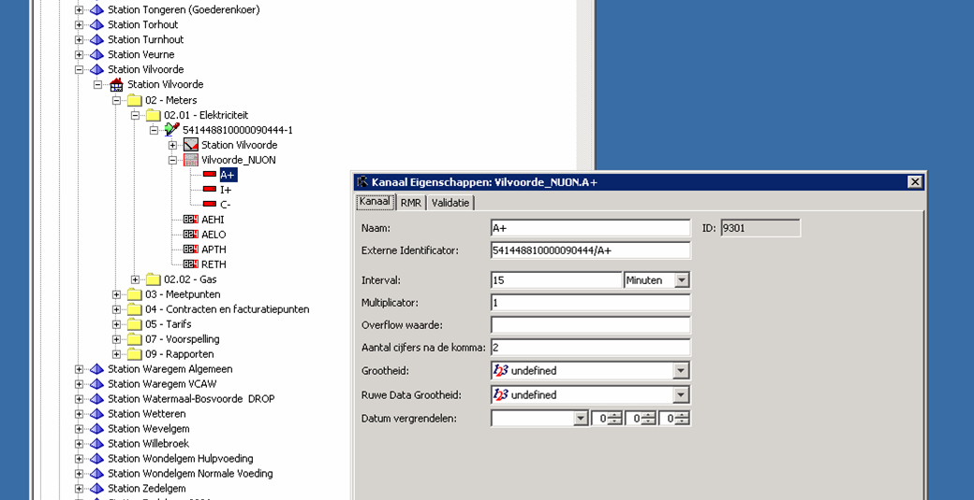
Automatic import of consumptions

Slide 4
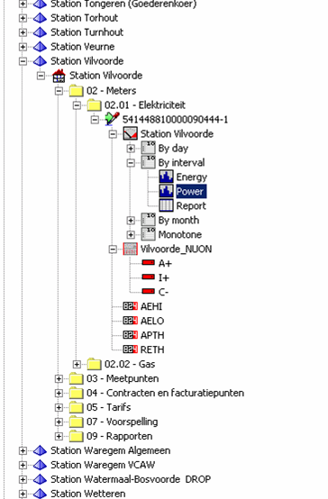
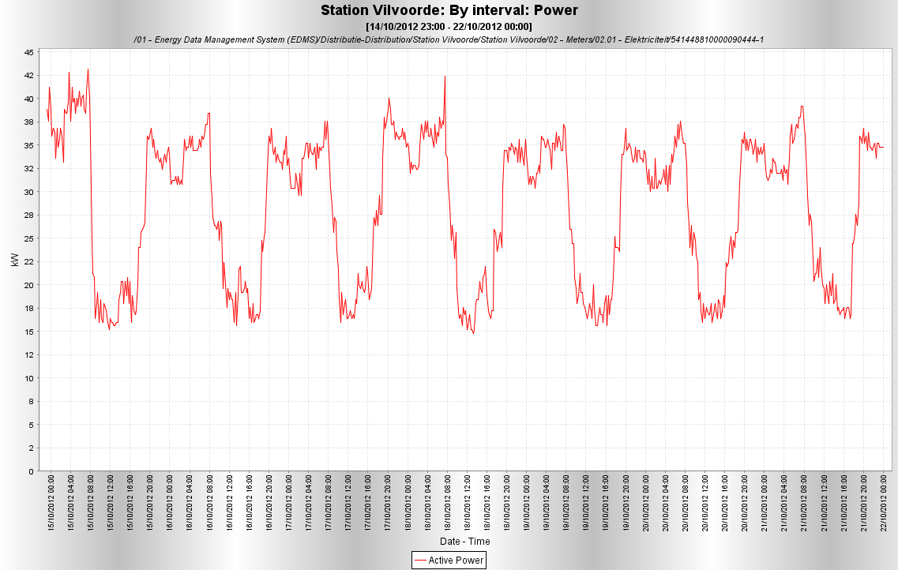
Reporting in graphs and reports (possible by day, by interval and by month)

Slide 5
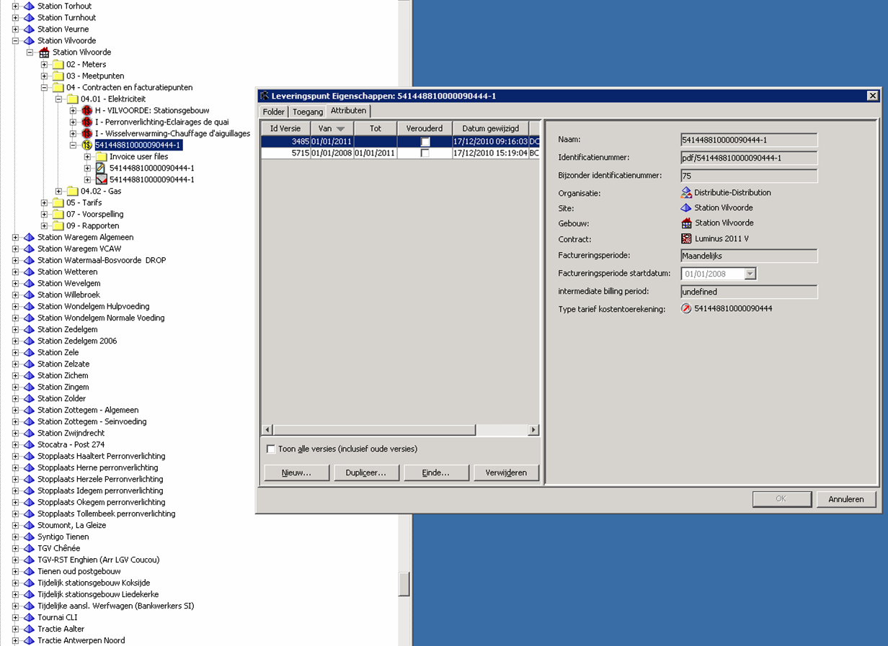
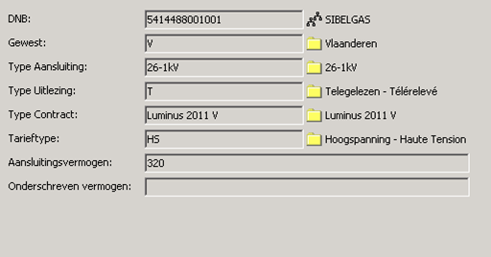
Parameters for supply point (versions with start and end time)

Slide 6
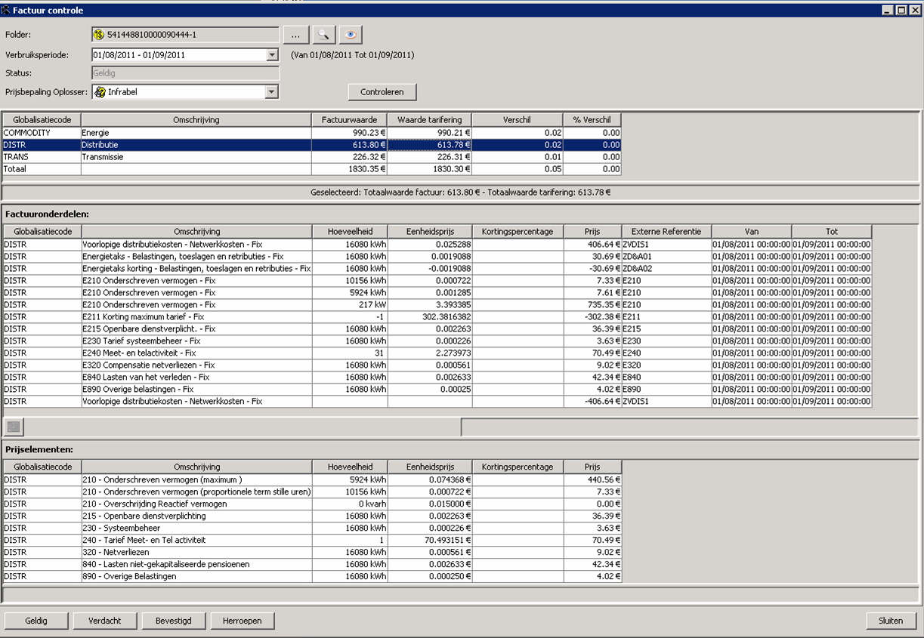
Invoice verification for each EAN and for each consumption period.
Invoice details regarding distribution
Invoice simulation regarding distribution
6

Slide 7
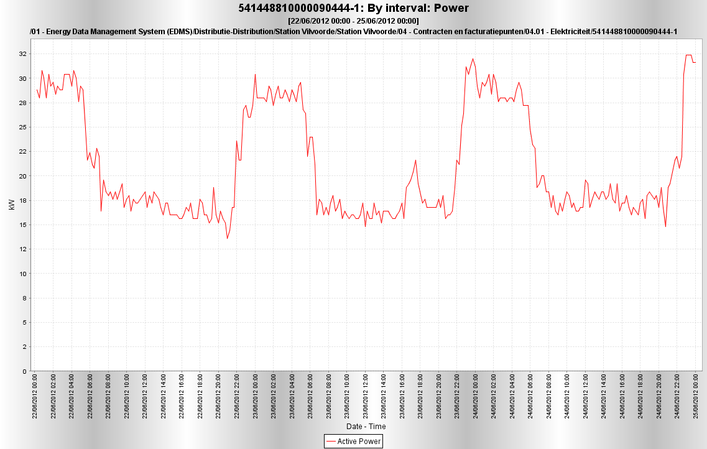
Cost allocation to e.g. platform lighting
16 kW
From sunset to sunrise
7

Slide 8
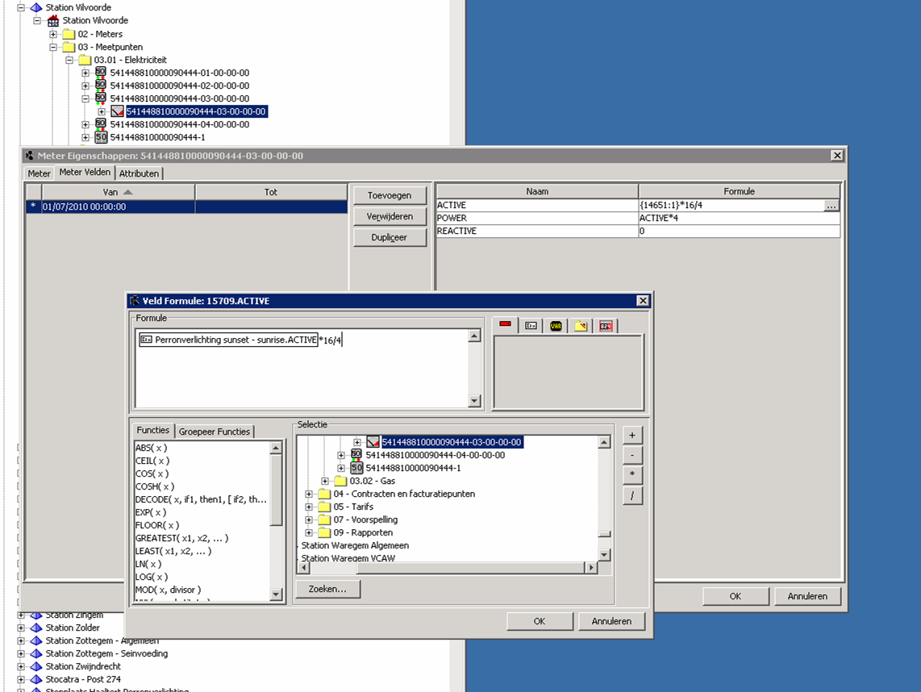
Formula for virtual meter (versions possible)
8

Slide 9
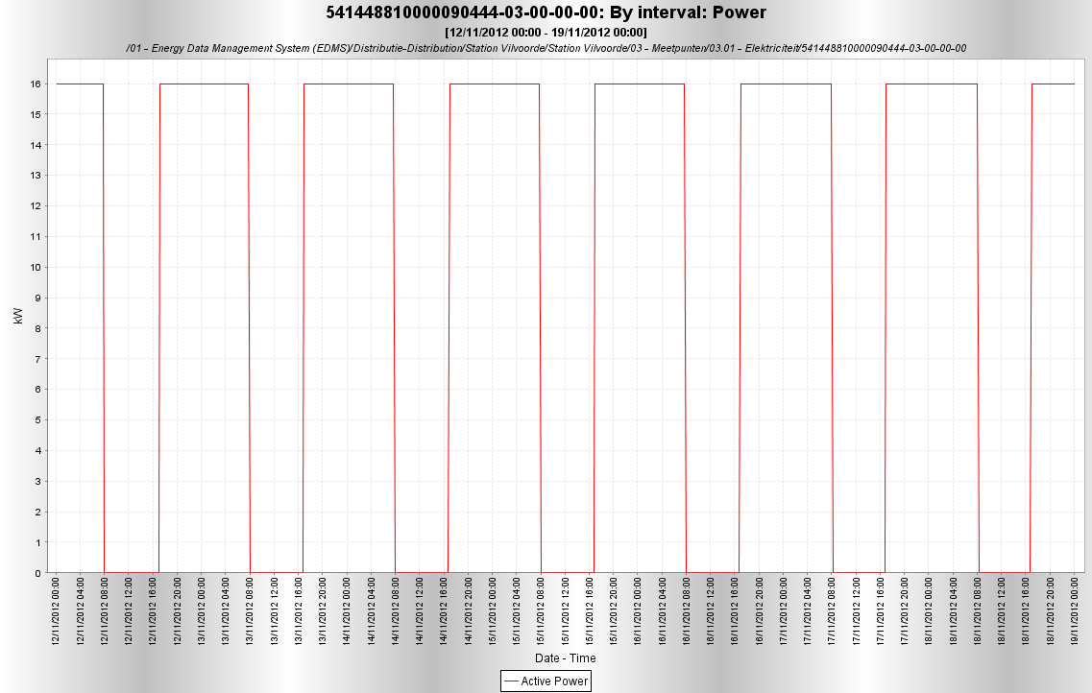
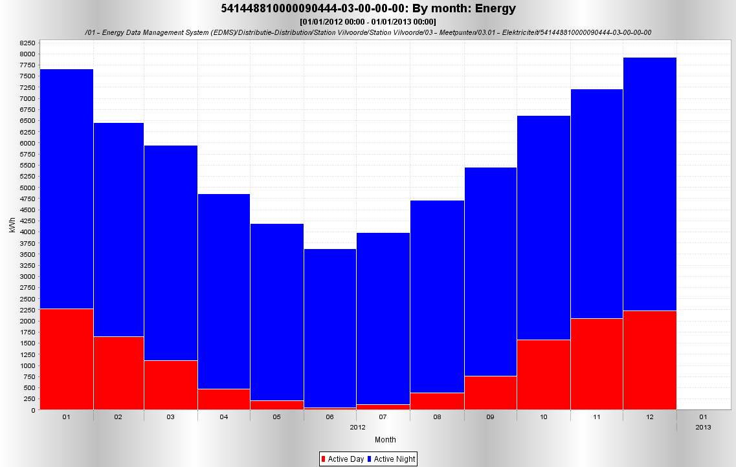

Slide 10
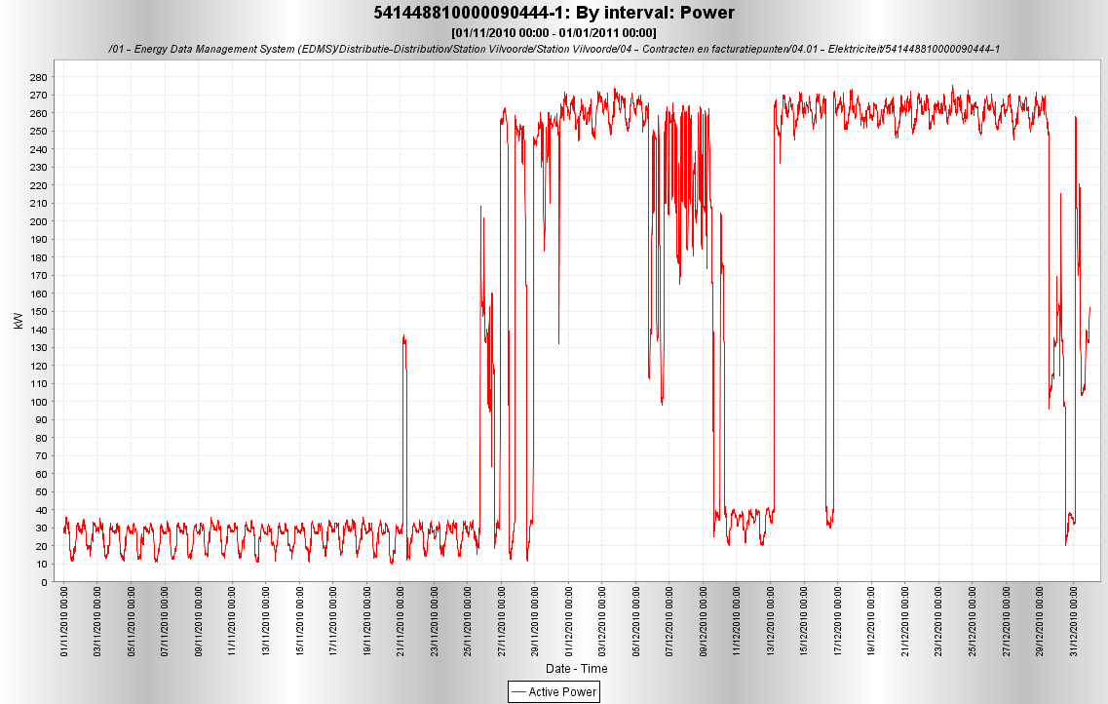
Cost allocation to switch heating
Snow, continuously on
Positive temperature and now snow
Cold, temperature regulated
230 kW

Slide 11
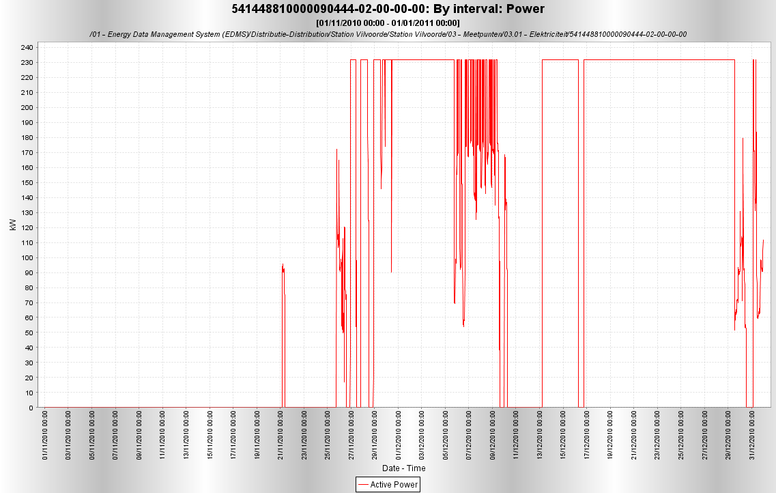
Complex formula allocates this consumption to switch heating

Slide 12
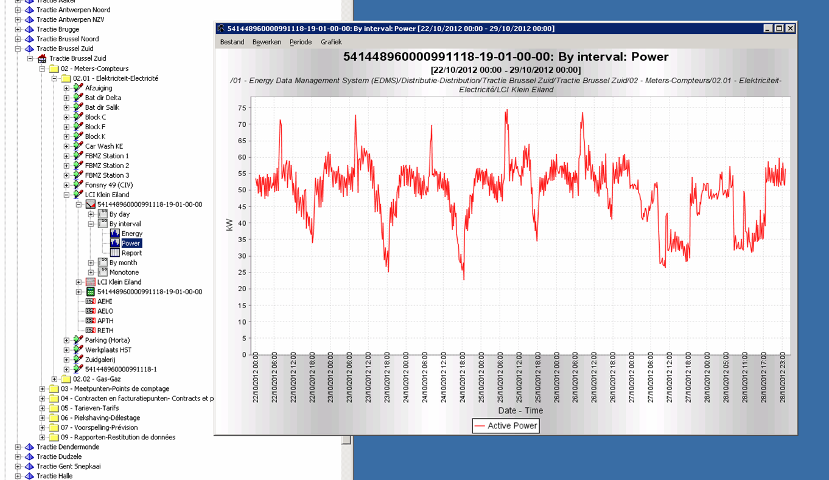
Tele-measured sub-metering point: via datalogger, meter with integrated datalogger and via own supervision systems
12

Slide 13
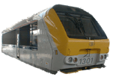
When do we need a submeter?
substation
telemeasured
MV
MV
LV
switch heating
station
MV
LV
signalling
signalling
station
building
LV
signalling
maintenance shop SNCB

Slide 14
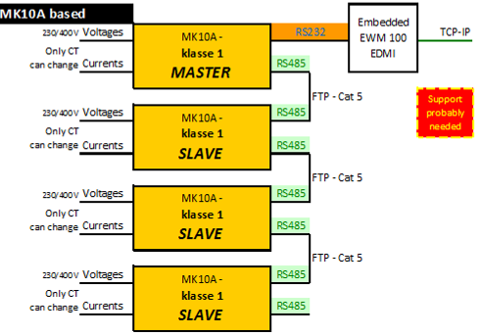
Example 1: EDMI of Steel
Moxa
TCP-IP
Eziview
EIServer

Slide 15
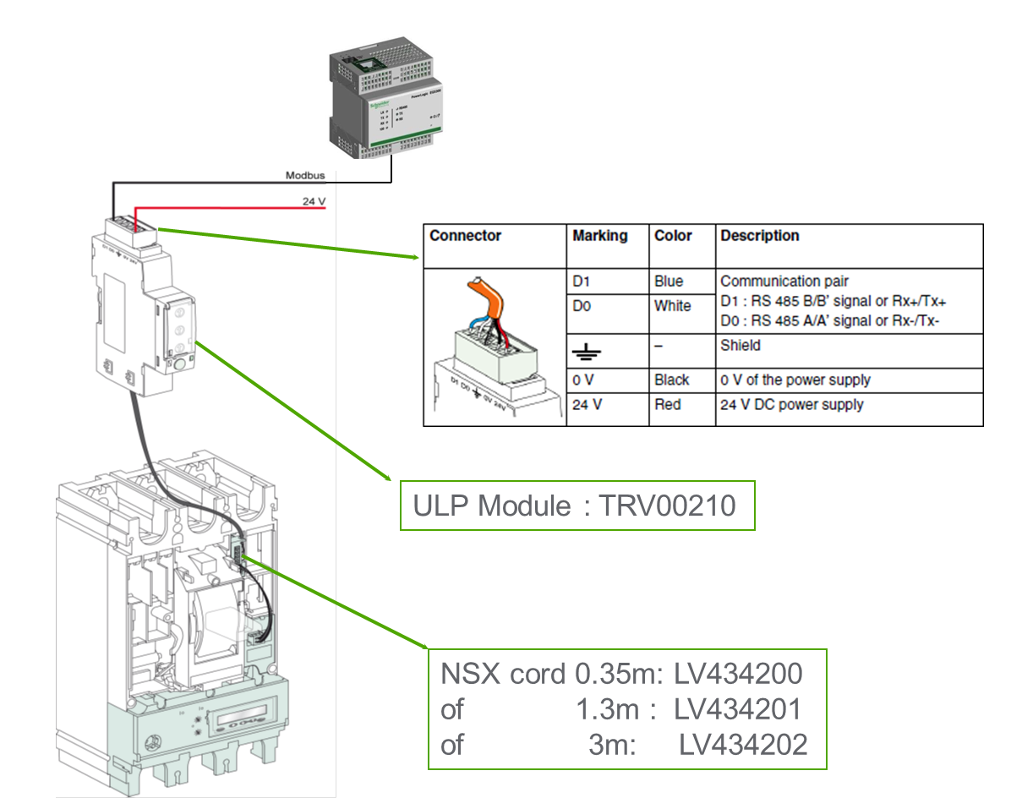
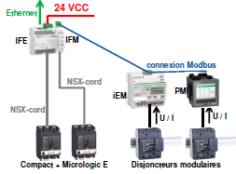
Example 2: NSX, PM and iEM of Schneider
24 V DC supply : ABL7RM24025
Struxureware Power Monitoring Expert
EIServer
Kies iEM3x55 indien bidirectionele stroommeting nodig is.
* Micrologic E op NSX only has a sufficient accuracy starting from 10% of nominal current

Slide 16
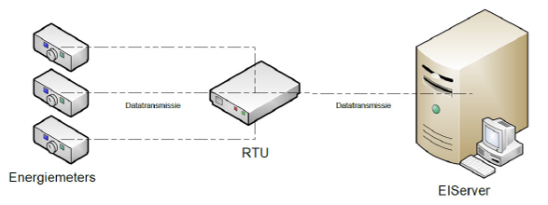
Example 3: with a datalogger
Energy management system Infrabel
Up to 32 energy meters: with potential free pulses
Also possible to connect meters via Modbus with RTU

Slide 17
Example 4: supervision system as datalogger
Supervision system collects every 15’ the data consumption
Every night a file with consumptions of previous day is exported
EIServer collects CSV-file from FTP-server
Format:
HAS_TRPAO 15 Q415/A+,20141105 00:00,2,9.5,1
HAS_TRPAO 15 Q415/A+,20141105 00:15,2,11.0,1
HAS_TRPAO 15 Q415/A+,20141105 00:30,2,8.4,1
Element | Explanation
Name | unique ID for channal
Date and time | date and time at end of measurement period (different formats possible)
Offset | the offset of time to UTC (2 hours in summer and 1 hour in winter)
Value | consumption (in kWh)
Quality | can be used to give a quality code of the measured value

Slide 18
?
QUESTIONS

