Slide 1
Renewable energy on and to be used by railway assets
Energy Network, Paris – 02/07/2018
Wim Bontinck
Chairman EES Platform
Environmental and energy manager NMBS/SNCB

Slide 2
Drivers for more “own” renewable energy production
Financial
Constantly lower prices of solar panels and wind turbines
Lower subsidies (value of allowed regional green certificates)
Still a business case
Ecological benefit
Social responsibility: contribution to the energy transition/ revolution

Slide 3
Cost of solar panels
Bottom price still not reached

Slide 4
Solar panels installations on NMBS or Infrabel assets
 |  | Infrabel | NMBS
 | # assets | kWp | kWp
2011 | 2 | 4700
2010-2016 | 10 | 125
2010-2016 | 4 |  | 100
2017 | 3 |  | 520
2018 | 1 | 50
2018 | 8 |  | 3700
 |  | 4875 | 4320
Workshop energy non traction Paris 02/07/2018

Slide 5
Financial model of NMBS PV projects
Third party investor
Builds and finances
Maintains first 10 years
Guarantees production volume
NMBS
Uses the electricity at a lower price compared to the electricity from the public grid, hopefully during at least 25 years
Becomes owner of the installation from year 11 (0 EUR)

Slide 6
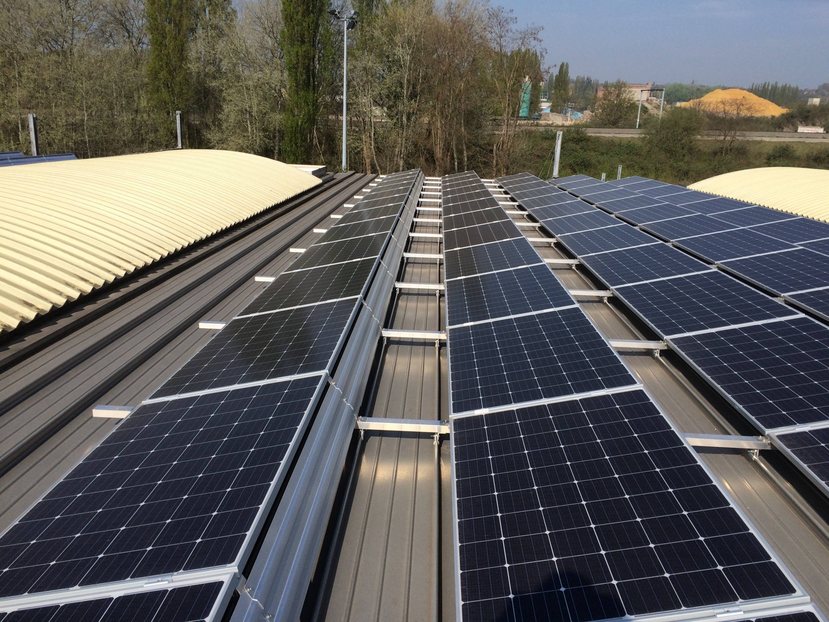
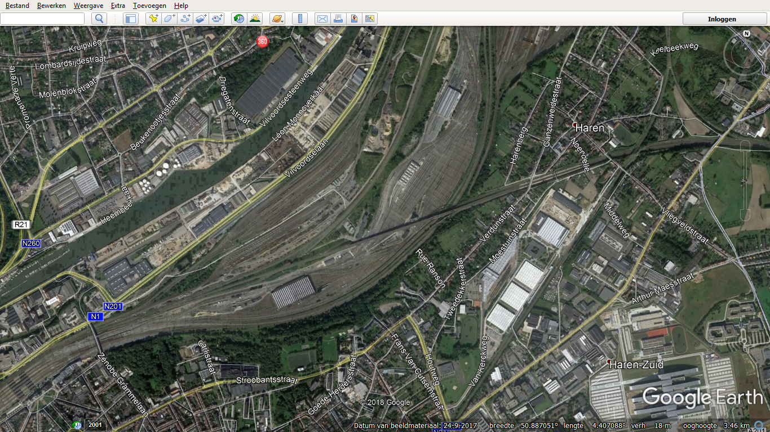
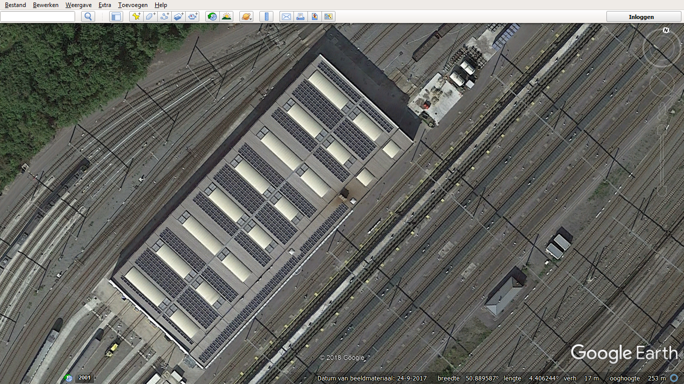

Slide 7
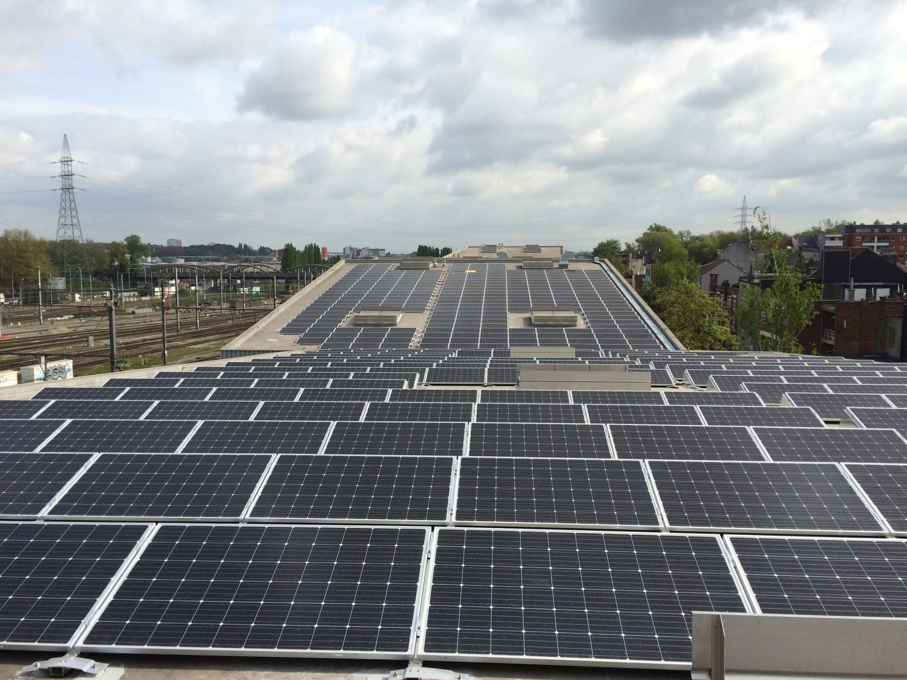
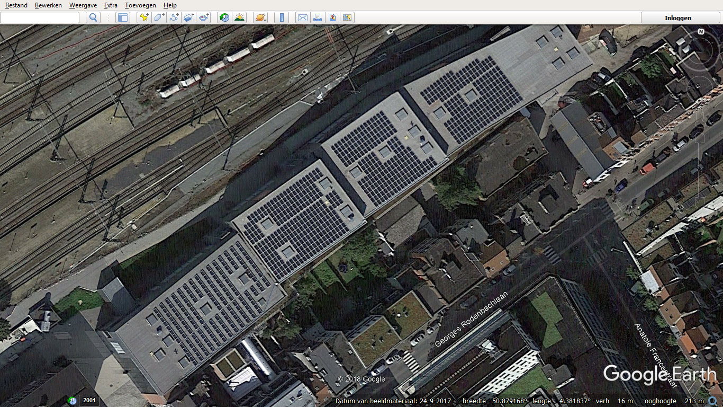
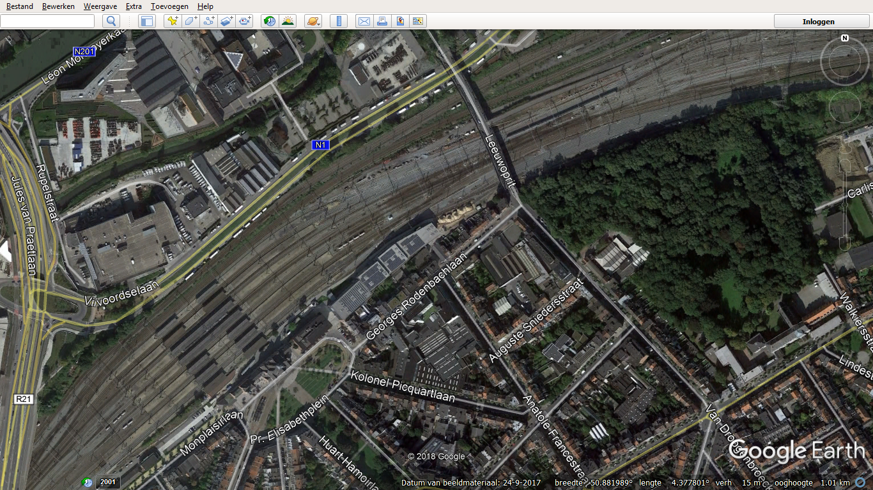

Slide 8
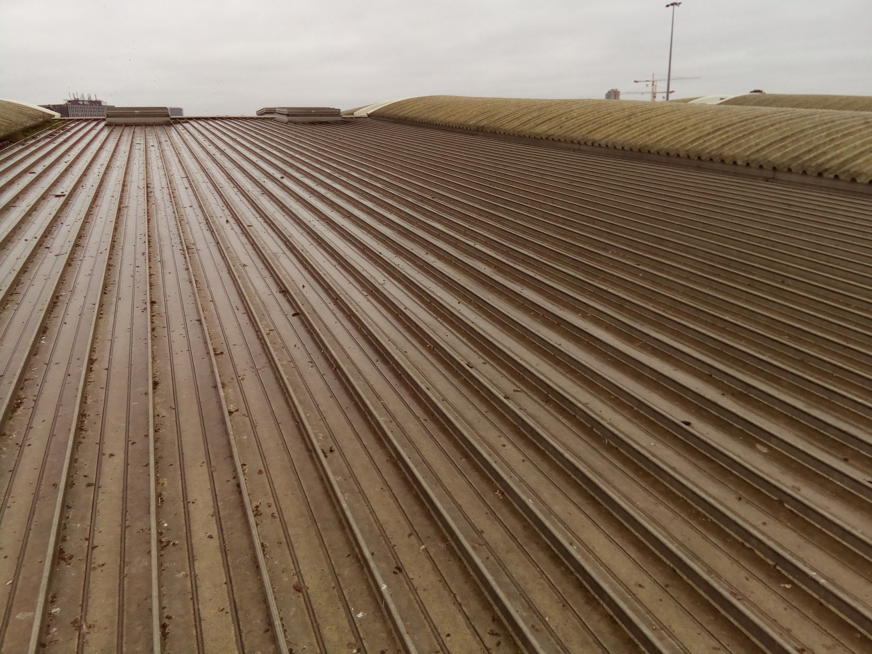
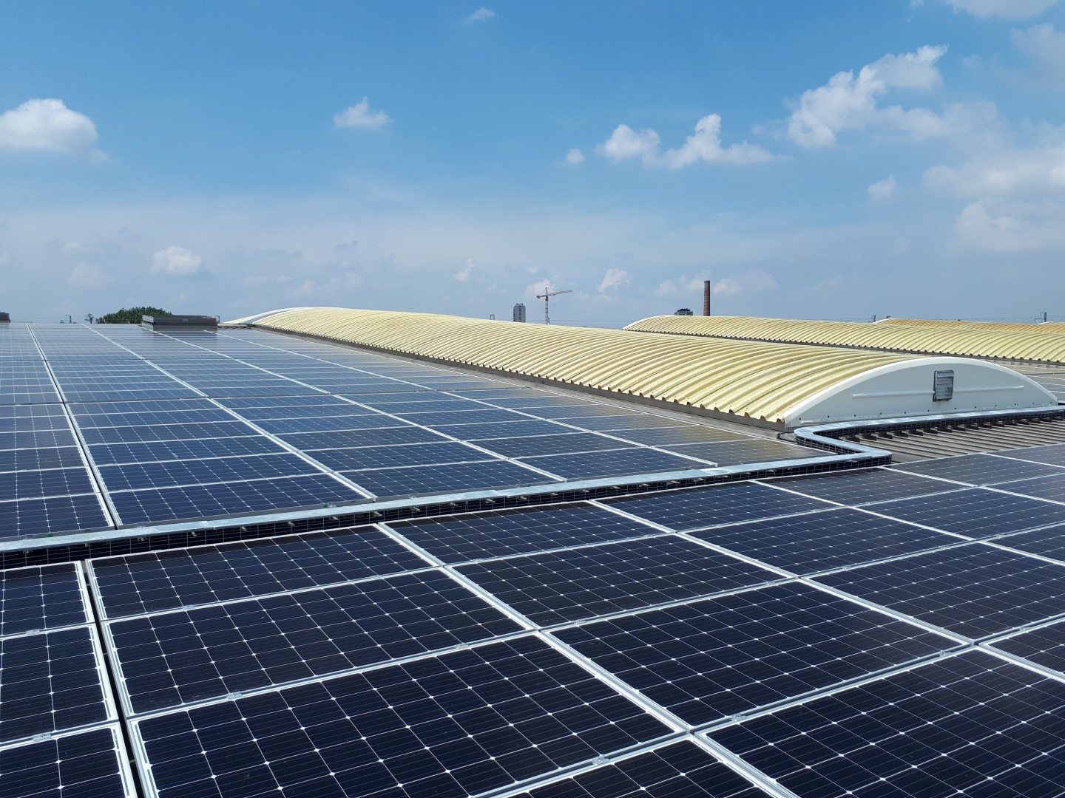
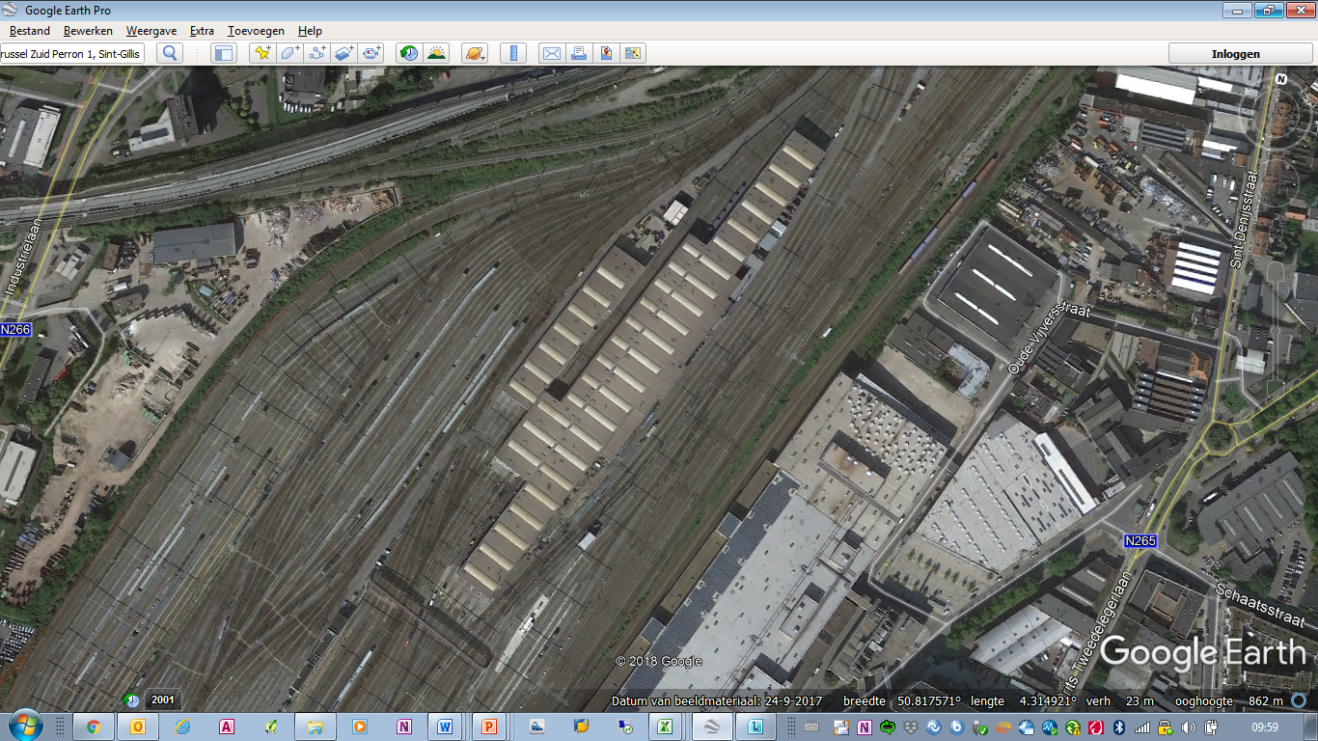
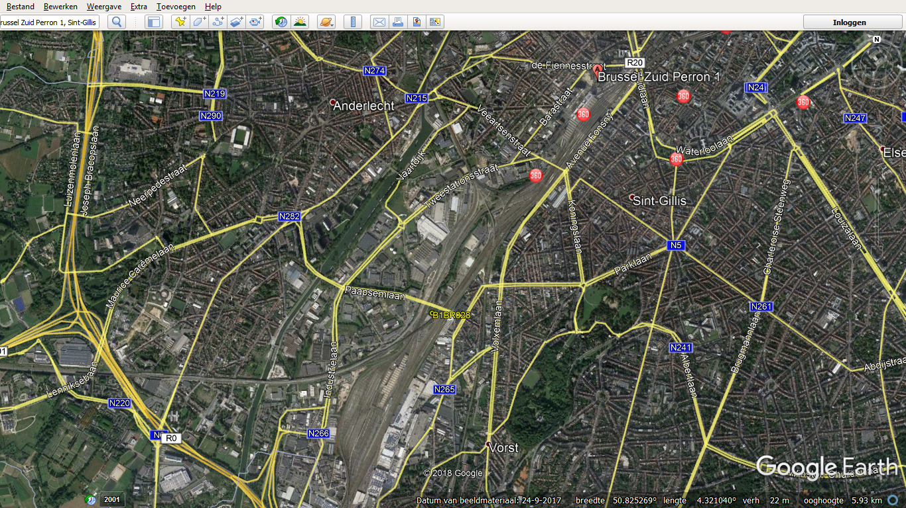

Slide 9
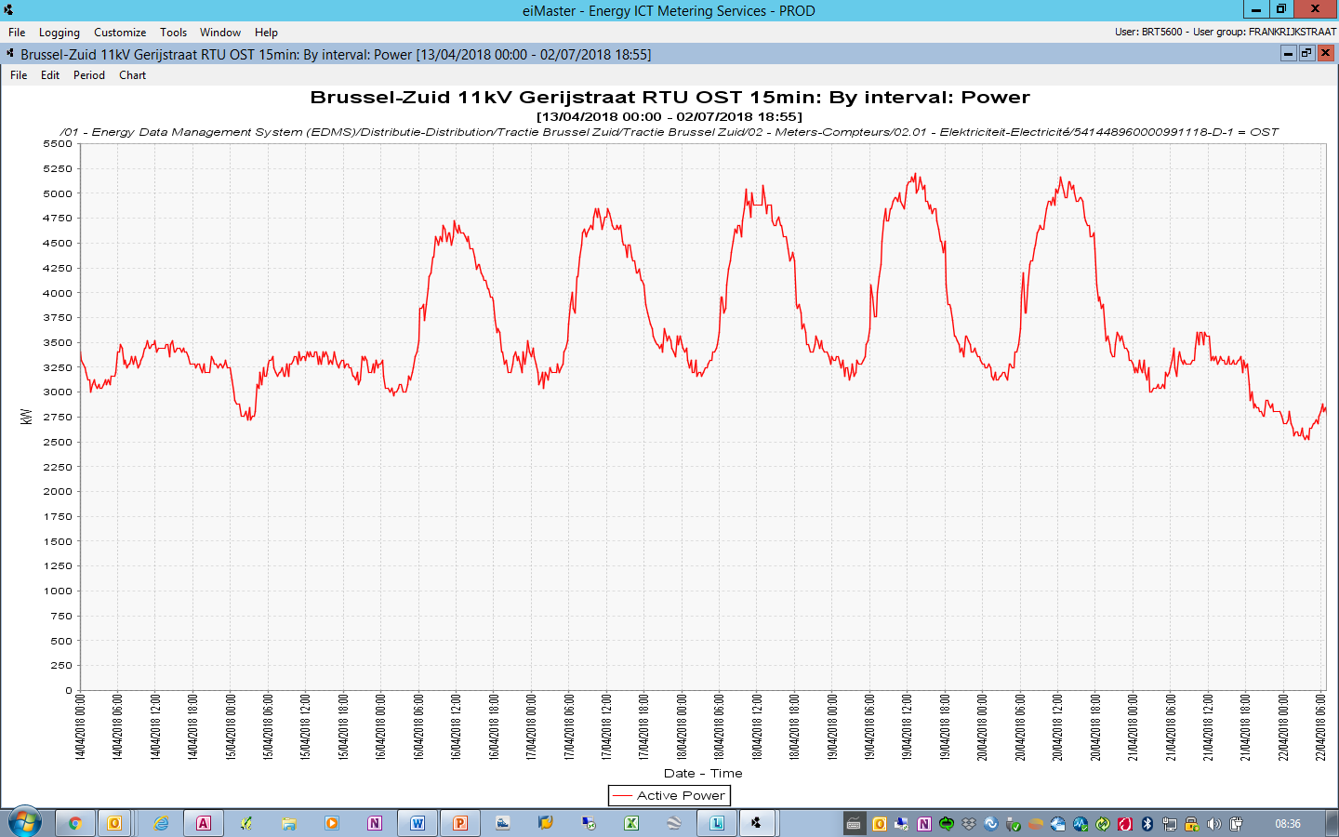
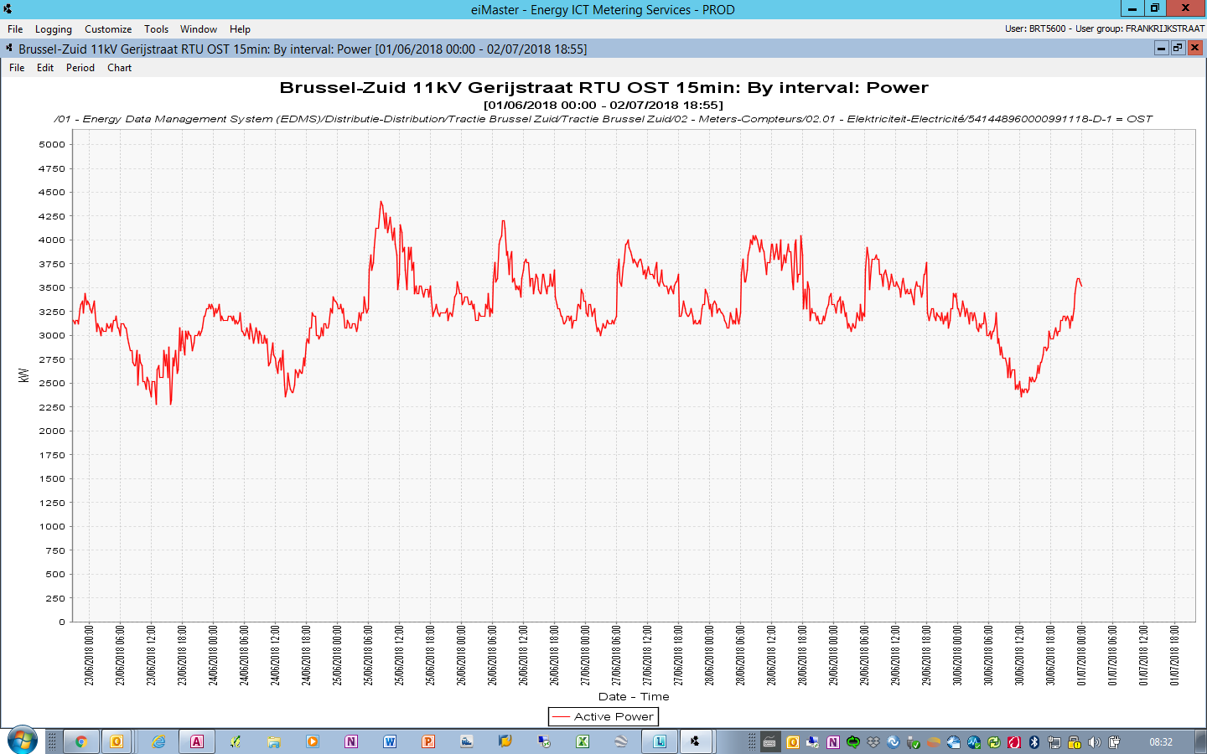

Slide 10
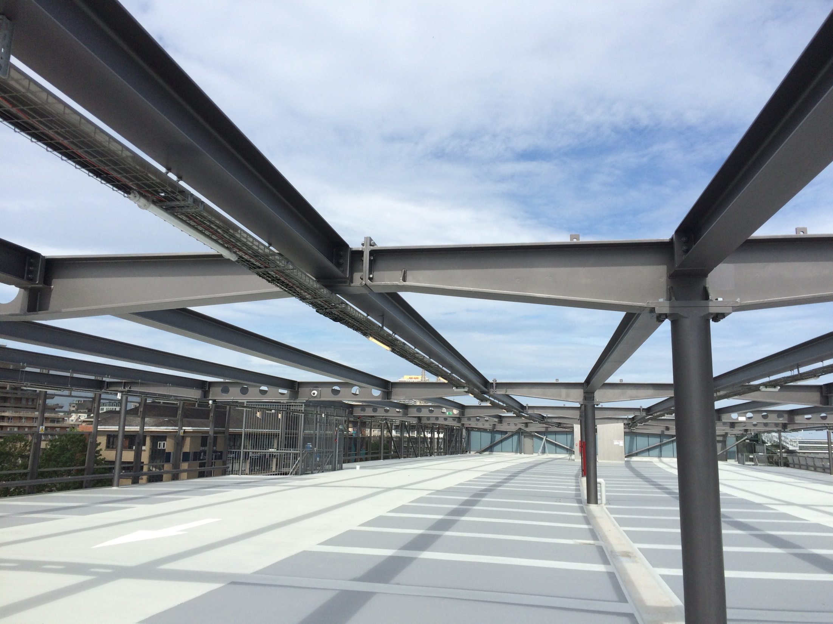
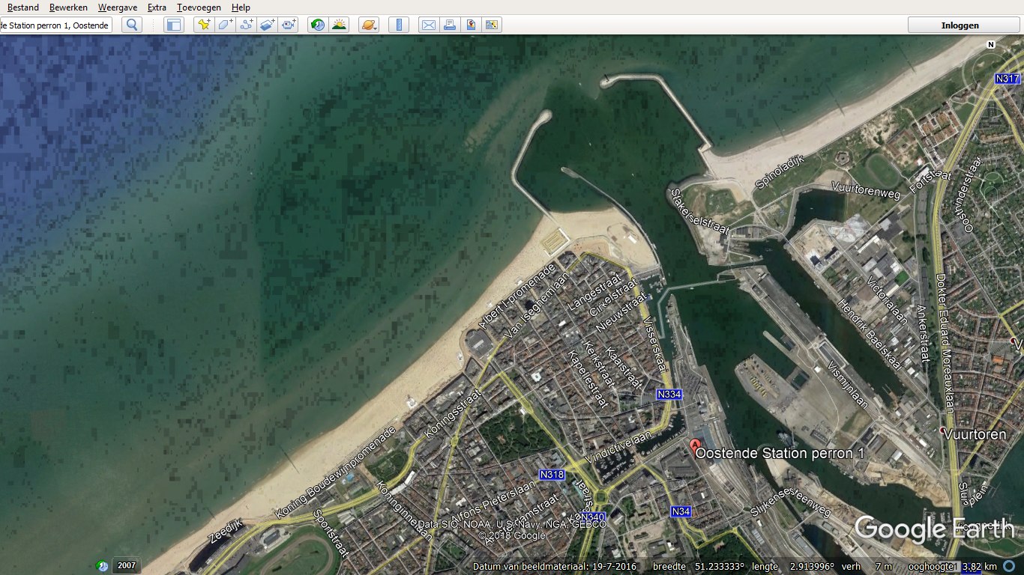
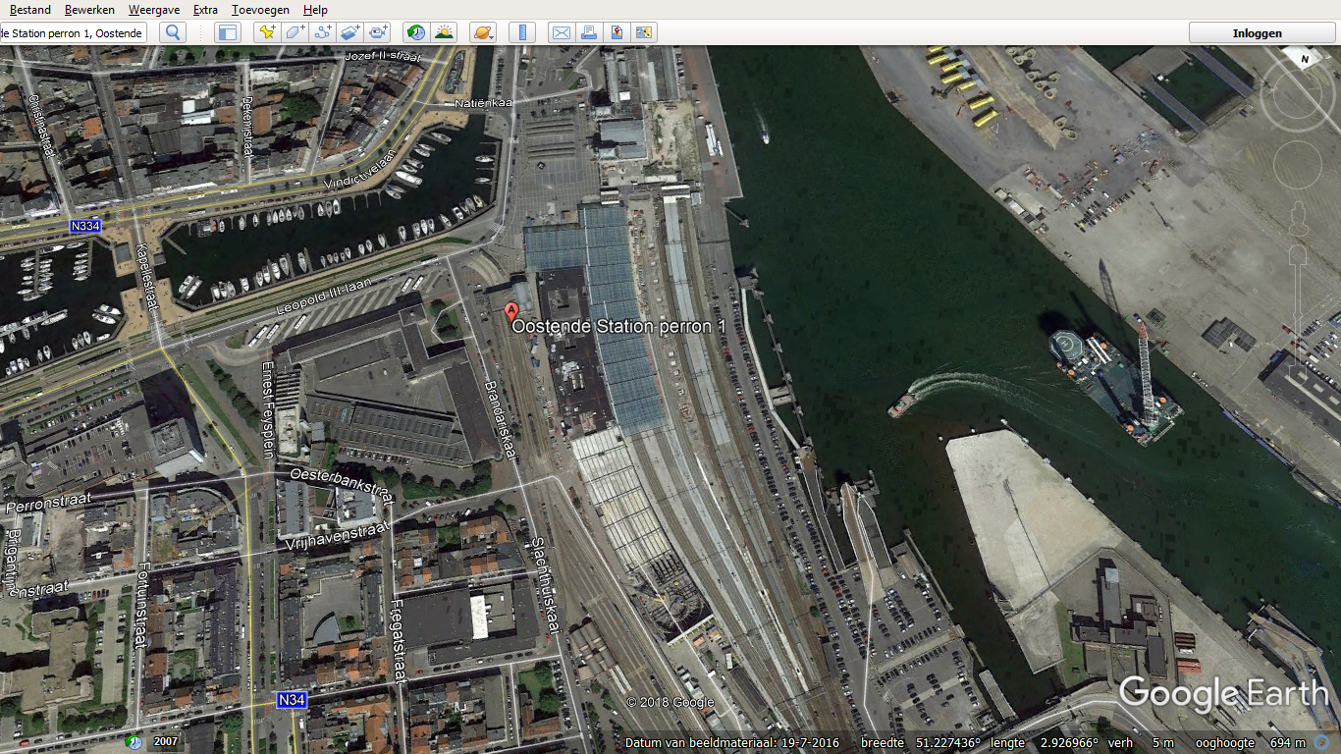

Slide 11
Enjoy a sunny future
Butt with now and then some rain…
To clean the solar panels
☺

